Slide 1
References
Jeff (CHI-HSUAN HO)

Slide 2
Bioinformatics Analysis – Genotyping (GT), APT, CPT
Jeff (CHI-HSUAN HO)

Slide 3
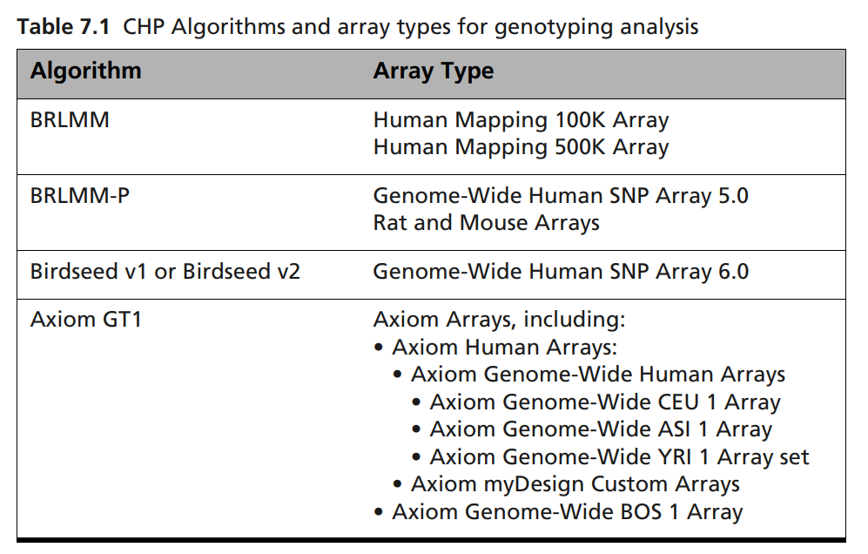
Genotyping Analysis Development and Deployment
Genotyping Procedure Documents for Each Chip
( )
GTC v4.2 P/N 702982 Rev. 3

Slide 4
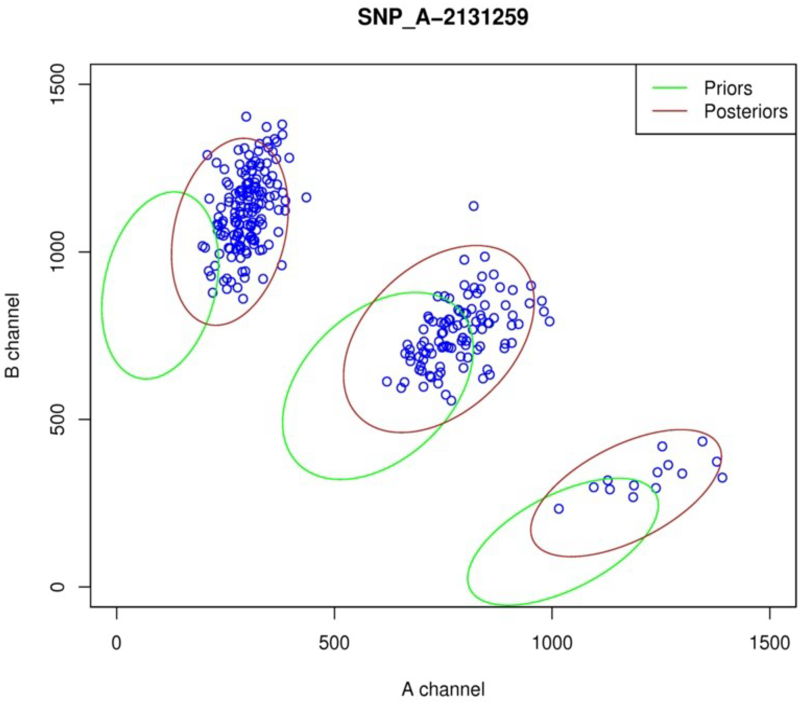
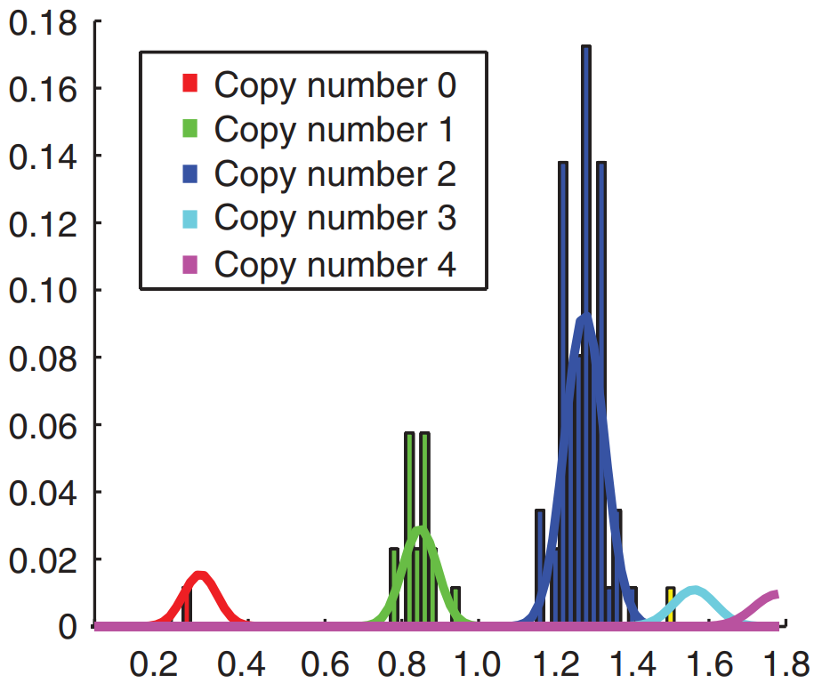

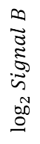
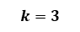
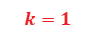
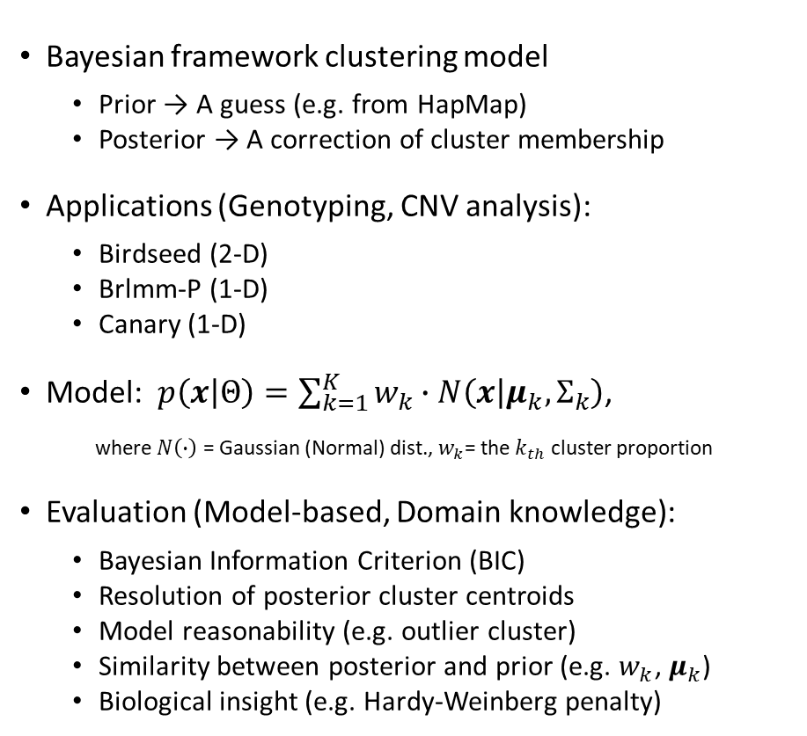
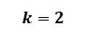

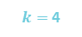
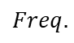
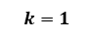
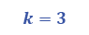
Gaussian Mixture Model (GMM)
SNP_A-2131259
$$k=1$$
Bayesian framework clustering model
Prior → A guess (e.g. from HapMap)
Posterior → A correction of cluster membership
Applications (Genotyping, CNV analysis):
Birdseed (2-D)
Brlmm-P (1-D)
Canary (1-D)
Model: $p\left(x | Θ\right)=\sum_{k=1}^{K}{w_{k}}∙N\left(x | μ_{k}, Σ_{k}\right)$,
where $N\left(∙\right)$ = Gaussian (Normal) dist., $w_{k}$= the $k_{th}$ cluster proportion
Evaluation (Model-based, Domain knowledge):
Bayesian Information Criterion (BIC)
Resolution of posterior cluster centroids
Model reasonability (e.g. outlier cluster)
Similarity between posterior and prior (e.g. $w_{k}$, $μ_{k}$)
Biological insight (e.g. Hardy-Weinberg penalty)
$$k=2$$
0
8.9
9.9
10.5
$$\log_{2}{Signal B}$$
$$k=3$$
0
8.9
9.9
10.5
$$k=3$$
$$Freq.$$
$$k=2$$
$$k=1$$
$k=$ 4
$$\log_{2}{Signal A}$$

Slide 5
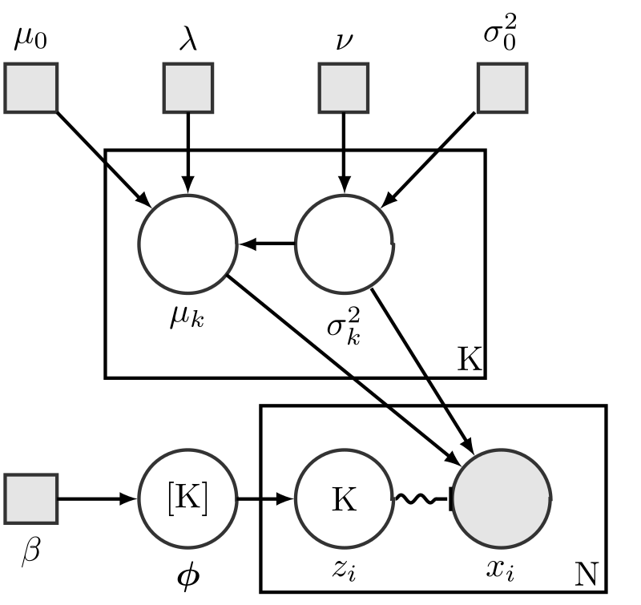
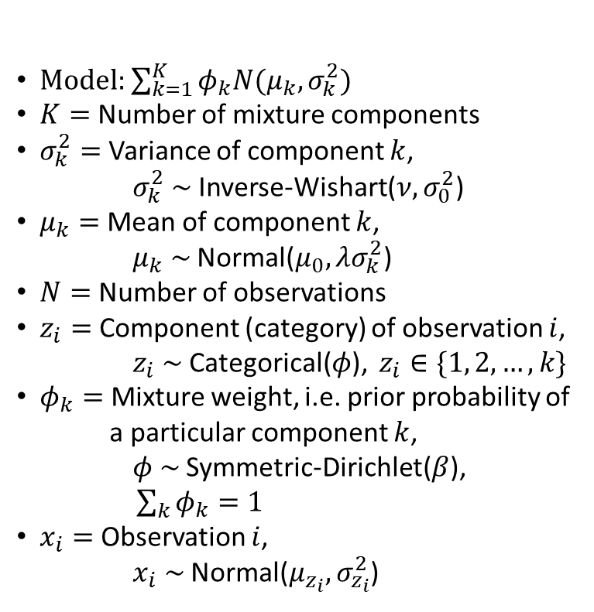
Bayesian Gaussian Mixture Model
Model: $\sum_{k=1}^{K}{φ_{k}N(μ_{k}, σ_{k}^{2})}$
$K=$ Number of mixture components
$σ_{k}^{2}=$ Variance of component $k$,
$σ_{k}^{2} \sim$ Inverse-Wishart($ν,σ_{0}^{2}$)
$μ_{k}=$ Mean of component $k$,
$μ_{k} \sim$ Normal($μ_{0},λσ_{k}^{2}$)
$N=$ Number of observations
$z_{i}=$ Component (category) of observation $i$,
$z_{i} \sim$ Categorical($φ$), $z_{i}∈\{1, 2, …, k\}$
$φ_{k}=$ Mixture weight, i.e. prior probability of
a particular component $k$,
$φ \sim$ Symmetric-Dirichlet($β$),
$\sum_{k}{φ_{k}}=1$
$x_{i}=$ Observation $i$,
$x_{i} \sim$ Normal($μ_{z_{i}},σ_{z_{i}}^{2}$)

Slide 6
Genotyping Analysis Development and Distribution
AxiomGT Framework
Training samples
Test samples
Auxiliary
Params
Data Loader
CDF
Data Loader
Target Sketch Estimation
MDL
Quantile Normalization
Quantile Normalization
Allele Summarization
Probe-set List
Allele Summarization
Signal Space Transformation
Signal Space Transformation
AxiomGT <Call>
AxiomGT <Train>
MDL
Genotyping Results
Web Browser
Notes:
Channel name caused by hdf5
VCF definition failure: correct => A: ref, B: alt
Image convert to heatmap: Y need to be inversed.

Slide 7
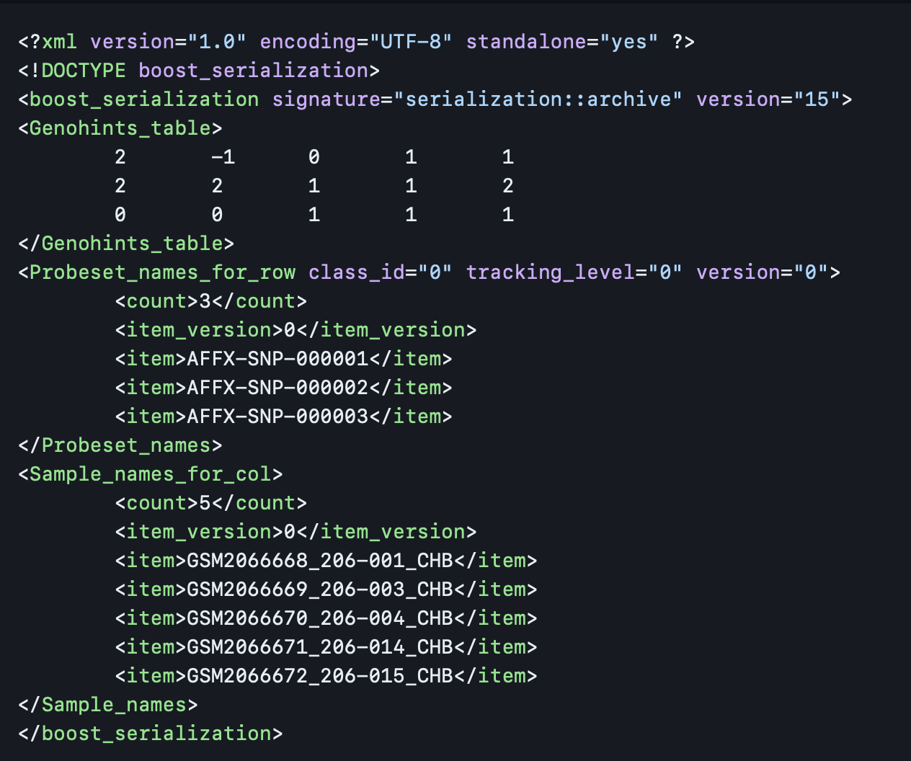
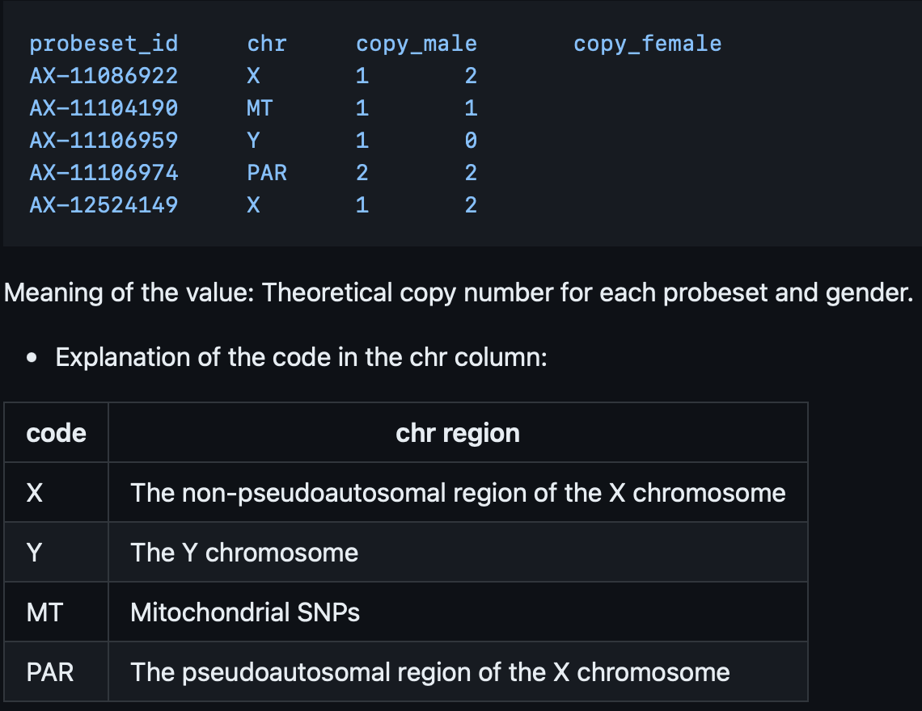
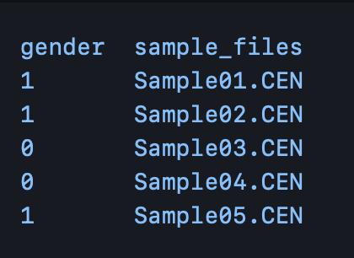
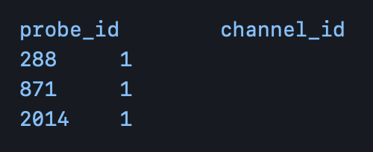
Genotyping Analysis Development and Distribution
Auxiliary
Params
Genotype
Special SNPs
Genders
Sex Probes
Notes:
Channel name caused by hdf5
VCF definition failure: correct => A: ref, B: alt
Image convert to heatmap: Y need to be inversed.

Slide 8
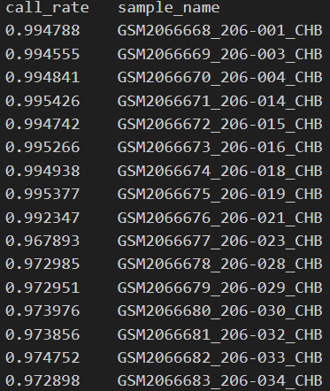
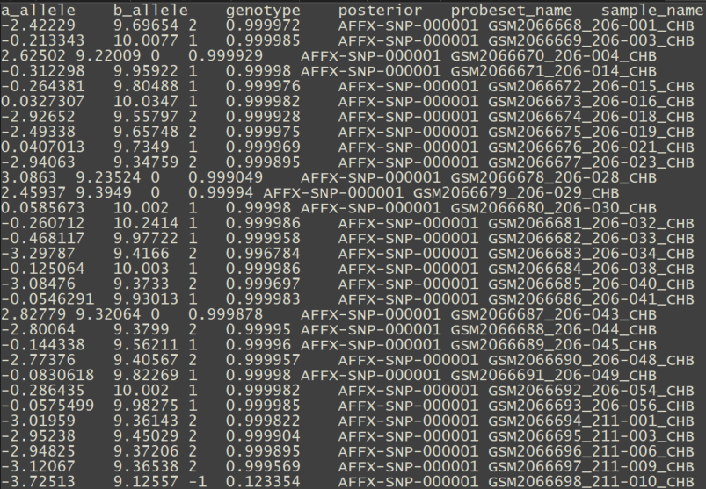
Genotyping Analysis Development and Distribution
Genotyping Results
Call Rate
Genotype Inference Report
Notes:
Channel name caused by hdf5
VCF definition failure: correct => A: ref, B: alt
Image convert to heatmap: Y need to be inversed.

Slide 9
Genotyping Analysis Development and Distribution
Training samples (CEL)
AxiomGT1 Algo (bayes_label)
initialize_bins
(x -> bins domain)
Integratebrlmmoverlabelings (bins domain)
labels_two_posterior
(bins domain)
make_two_calls
(bins domain params results
-> x calls)
Data and Parameters Loader
Target Sketch Estimation
Quantile Normalization
Probe Sets Summarization
Alleles Summarization
Signal Space Transformation (MvA)
GMM Bayesian Update
Genotype Calls and Confidences
Notes:
Channel name caused by hdf5
VCF definition failure: correct => A: ref, B: alt
Image convert to heatmap: Y need to be inversed.

Slide 10
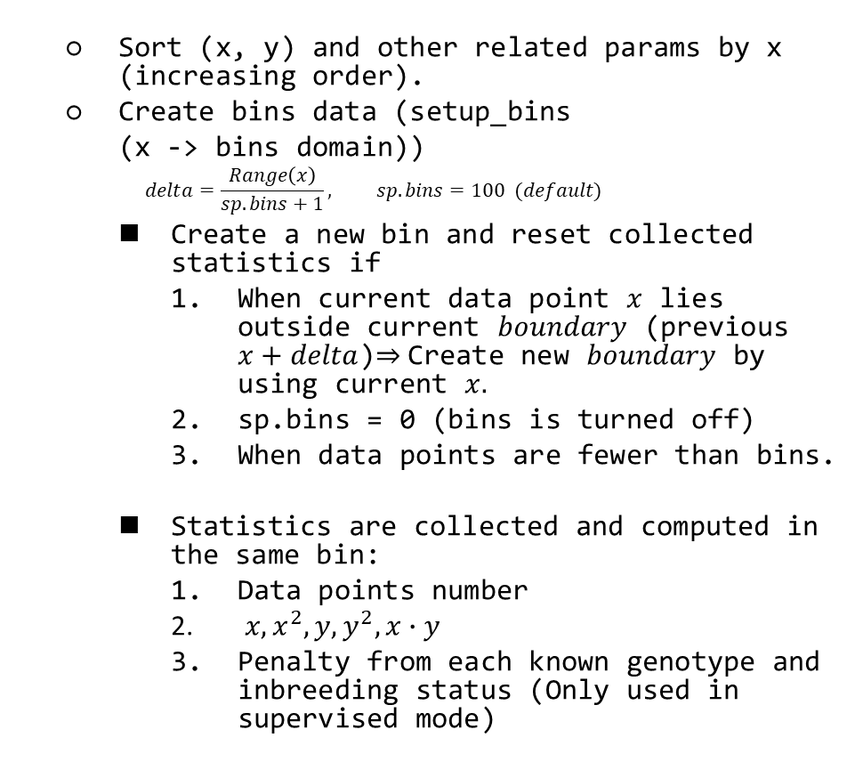
Genotyping Analysis Development and Distribution
Training samples (CEL)
Sort (x, y) and other related params by x (increasing order).
Create bins data (setup_bins
(x -> bins domain))
$$delta=\frac{Range\left(x\right)}{sp.bins+1}, sp.bins=100 (default)$$
Create a new bin and reset collected statistics if
When current data point $x$ lies outside current $boundary$ (previous $x+delta$)$⇒$Create new $boundary$ by using current $x.$
sp.bins = 0 (bins is turned off)
When data points are fewer than bins.
Statistics are collected and computed in the same bin:
Data points number
$x,x^{2}, y, y^{2}, x∙y$
Penalty from each known genotype and inbreeding status (Only used in supervised mode)
Data and Parameters Loader
Target Sketch Estimation
Quantile Normalization
Probe Sets Summarization
Alleles Summarization
Signal Space Transformation (MvA)
GMM Bayesian Update
Genotype Calls and Confidences

Slide 11
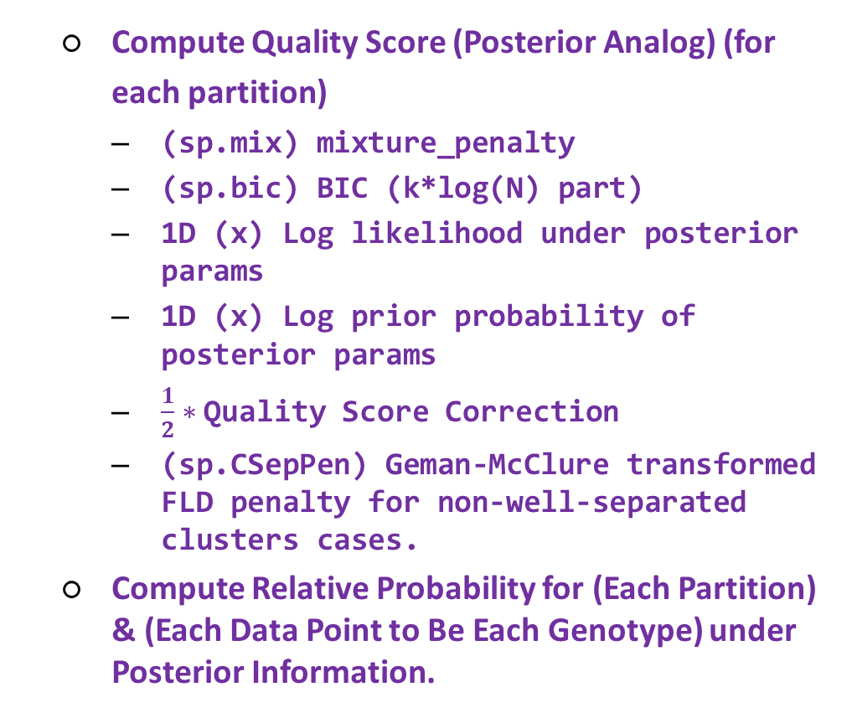
Genotyping Analysis Development and Distribution
Training samples (CEL)
Compute Quality Score (Posterior Analog) (for each partition)
(sp.mix) mixture_penalty
(sp.bic) BIC (k*log(N) part)
1D (x) Log likelihood under posterior params
1D (x) Log prior probability of posterior params
$\frac{1}{2}∗$ Quality Score Correction
(sp.CSepPen) Geman-McClure transformed FLD penalty for non-well-separated clusters cases.
Compute Relative Probability for (Each Partition) & (Each Data Point to Be Each Genotype) under Posterior Information.
Data and Parameters Loader
Target Sketch Estimation
Quantile Normalization
Probe Sets Summarization
Alleles Summarization
Signal Space Transformation (MvA)
GMM Bayesian Update
Genotype Calls and Confidences

Slide 12
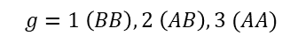
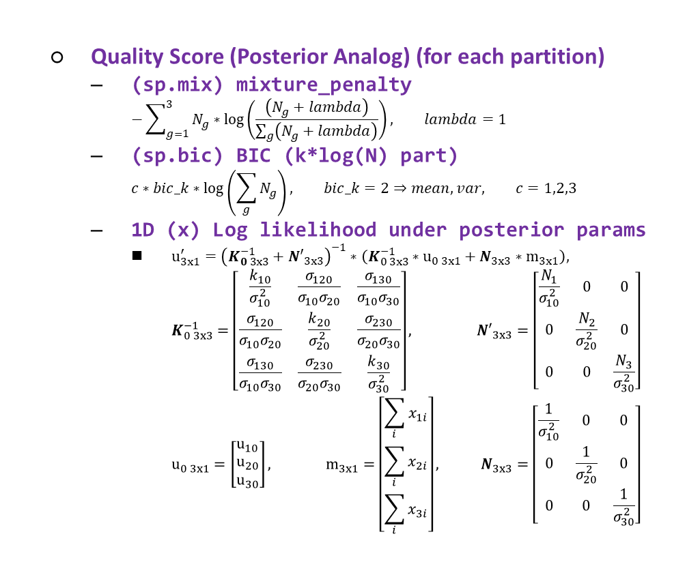
Genotyping Analysis Development and Distribution
Training samples (CEL)
Quality Score (Posterior Analog) (for each partition)
(sp.mix) mixture_penalty
$$−\sum_{g=1}^{3}{N_{g}∗\log\left(\frac{\left(N_{g}+lambda\right)}{\sum_{g}{\left(N_{g}+lambda\right)}}\right)}, lambda=1$$
(sp.bic) BIC (k*log(N) part)
$$c∗bic_k∗\log\left(\sum_{g}{N_{g}}\right), bic_k=2⇒mean, var, c=1,2,3$$
1D (x) Log likelihood under posterior params
$u_{3x1}^{′}={\left(K_{0 3x3}^{−1}+{N′}_{3x3}\right)}^{−1}∗\left(K_{0 3x3}^{−1}∗u_{0 3x1}+N_{3x3}∗m_{3x1}\right),$
$$K_{0 3x3}^{−1}=\left[\begin{matrix}\frac{k_{10}}{σ_{10}^{2}} & \frac{σ_{120}}{σ_{10}σ_{20}} & \frac{σ_{130}}{σ_{10}σ_{30}} \\ \frac{σ_{120}}{σ_{10}σ_{20}} & \frac{k_{20}}{σ_{20}^{2}} & \frac{σ_{230}}{σ_{20}σ_{30}} \\ \frac{σ_{130}}{σ_{10}σ_{30}} & \frac{σ_{230}}{σ_{20}σ_{30}} & \frac{k_{30}}{σ_{30}^{2}}\end{matrix}\right], {N′}_{3x3}=\left[\begin{matrix}\frac{N_{1}}{σ_{10}^{2}} & 0 & 0 \\ 0 & \frac{N_{2}}{σ_{20}^{2}} & 0 \\ 0 & 0 & \frac{N_{3}}{σ_{30}^{2}}\end{matrix}\right]$$
$$u_{0 3x1}=\left[\begin{matrix}u_{10} \\ u_{20} \\ u_{30}\end{matrix}\right], m_{3x1}=\left[\begin{matrix}\sum_{i}{x_{1i}} \\ \sum_{i}{x_{2i}} \\ \sum_{i}{x_{3i}}\end{matrix}\right], N_{3x3}=\left[\begin{matrix}\frac{1}{σ_{10}^{2}} & 0 & 0 \\ 0 & \frac{1}{σ_{20}^{2}} & 0 \\ 0 & 0 & \frac{1}{σ_{30}^{2}}\end{matrix}\right]$$
Data and Parameters Loader
$$g=1 \left(BB\right),2 \left(AB\right),3 (AA)$$
Target Sketch Estimation
Quantile Normalization
Probe Sets Summarization
Alleles Summarization
Signal Space Transformation (MvA)
GMM Bayesian Update
Genotype Calls and Confidences

Slide 13
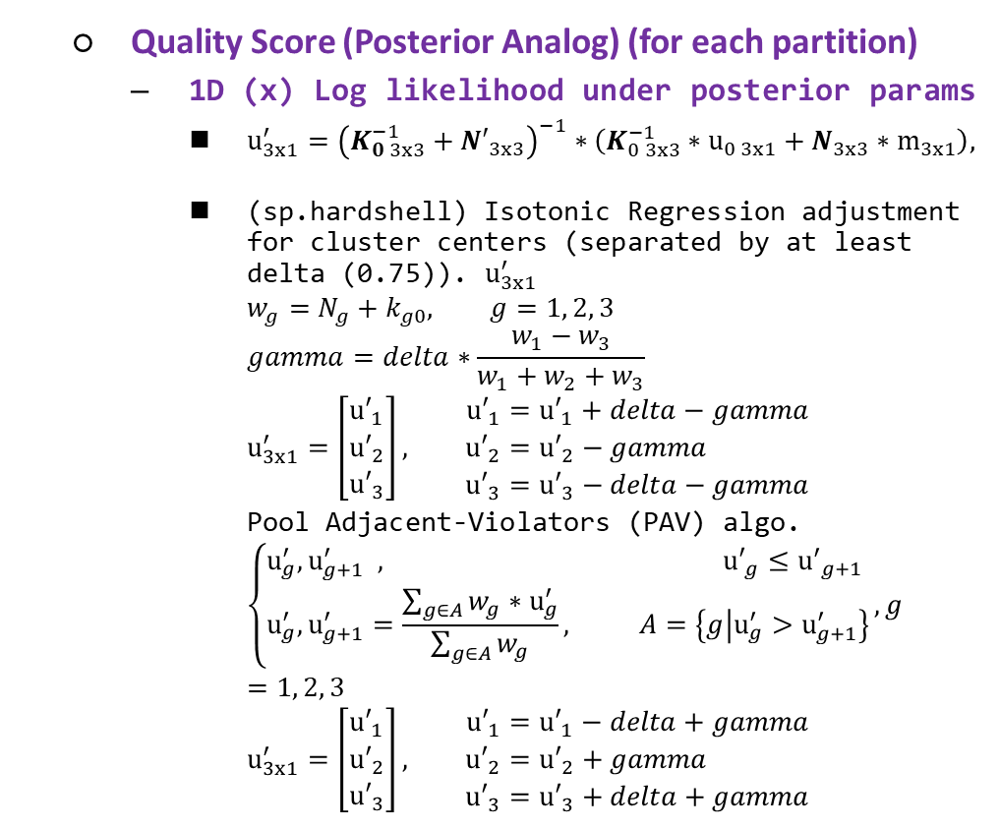
Genotyping Analysis Development and Distribution
Training samples (CEL)
Quality Score (Posterior Analog) (for each partition)
1D (x) Log likelihood under posterior params
$u_{3x1}^{′}={\left(K_{0 3x3}^{−1}+{N′}_{3x3}\right)}^{−1}∗\left(K_{0 3x3}^{−1}∗u_{0 3x1}+N_{3x3}∗m_{3x1}\right),$
(sp.hardshell) Isotonic Regression adjustment for cluster centers (separated by at least delta (0.75)). $u_{3x1}^{′}$
$$w_{g}=N_{g}+k_{g0}, g=1, 2, 3$$
$$gamma=delta∗\frac{w_{1}−w_{3}}{w_{1}+w_{2}+w_{3}}$$
$$u_{3x1}^{′}=\left[\begin{matrix}{u′}_{1} \\ {u′}_{2} \\ {u′}_{3}\end{matrix}\right], \begin{matrix}{u′}_{1}={u′}_{1}+delta−gamma \\ {u′}_{2}={u′}_{2}−gamma \\ {u′}_{3}={u′}_{3}−delta−gamma\end{matrix}$$
Pool Adjacent-Violators (PAV) algo.
$$\left\{\begin{aligned}u_{g}^{′}, u_{g+1}^{′} , {u′}_{g}≤{u^{′}}_{g+1} \\ u_{g}^{′}, u_{g+1}^{′}=\frac{\sum_{g∈A}{w_{g}}∗u_{g}^{′}}{\sum_{g∈A}{w_{g}}}, A=\left\{g | u_{g}^{′}>u_{g+1}^{′}\right\}\end{aligned}\right., g=1, 2, 3$$
$$u_{3x1}^{′}=\left[\begin{matrix}{u′}_{1} \\ {u′}_{2} \\ {u′}_{3}\end{matrix}\right], \begin{matrix}{u′}_{1}={u′}_{1}−delta+gamma \\ {u′}_{2}={u′}_{2}+gamma \\ {u′}_{3}={u′}_{3}+delta+gamma\end{matrix}$$
Data and Parameters Loader
Target Sketch Estimation
Quantile Normalization
Probe Sets Summarization
Alleles Summarization
Signal Space Transformation (MvA)
GMM Bayesian Update
Genotype Calls and Confidences

Slide 14
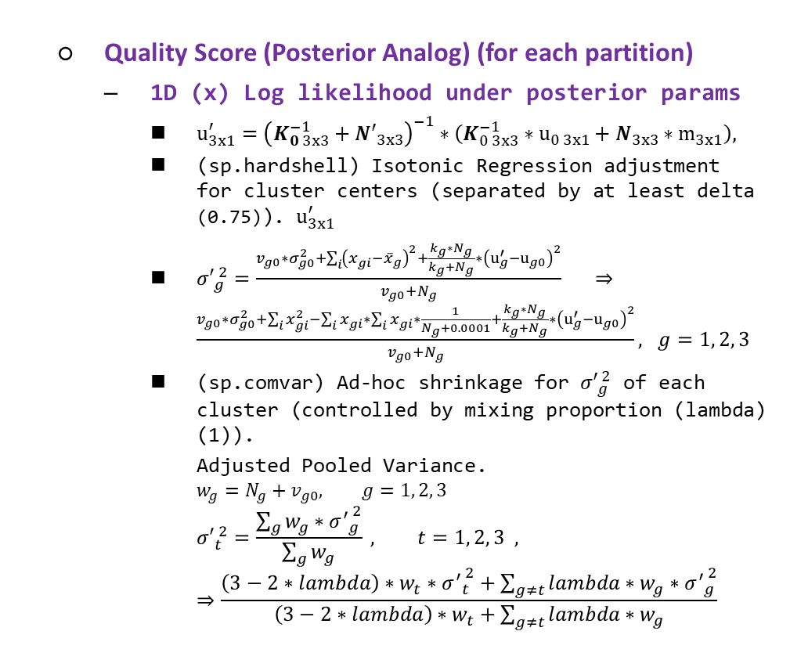
Genotyping Analysis Development and Distribution
Training samples (CEL)
Quality Score (Posterior Analog) (for each partition)
1D (x) Log likelihood under posterior params
$u_{3x1}^{′}={\left(K_{0 3x3}^{−1}+{N′}_{3x3}\right)}^{−1}∗\left(K_{0 3x3}^{−1}∗u_{0 3x1}+N_{3x3}∗m_{3x1}\right),$
(sp.hardshell) Isotonic Regression adjustment for cluster centers (separated by at least delta (0.75)). $u_{3x1}^{′}$
${σ′}_{g}^{ 2}=\frac{v_{g0}∗σ_{g0}^{2}+\sum_{i}{{\left(x_{gi}{−\overline{x}}_{g}\right)}^{2}}+\frac{k_{g}∗N_{g}}{k_{g}+N_{g}}∗{\left(u_{g}^{′}−u_{g0}\right)}^{2}}{v_{g0}+N_{g}} ⇒\frac{v_{g0}∗σ_{g0}^{2}+\sum_{i}{x_{gi}^{2}}−\sum_{i}{x_{gi}}∗\sum_{i}{x_{gi}}∗\frac{1}{N_{g}+0.0001}+\frac{k_{g}∗N_{g}}{k_{g}+N_{g}}∗{\left(u_{g}^{′}−u_{g0}\right)}^{2}}{v_{g0}+N_{g}}, g=1, 2, 3$
(sp.comvar) Ad-hoc shrinkage for ${σ′}_{g}^{ 2}$ of each cluster (controlled by mixing proportion (lambda) (1)).
Adjusted Pooled Variance.
$$w_{g}=N_{g}+v_{g0}, g=1, 2, 3$$
$${σ′}_{t}^{ 2}=\frac{\sum_{g}{w_{g}∗{σ^{′}}_{g}^{ 2}}}{\sum_{g}{w_{g}}} , t=1, 2, 3 , ⇒\frac{\left(3−2∗lambda\right)∗w_{t}∗{σ^{′}}_{t}^{ 2}+\sum_{g≠t}{lambda∗w_{g}∗{σ^{′}}_{g}^{ 2}}}{\left(3−2∗lambda\right)∗w_{t}+\sum_{g≠t}{lambda∗w_{g}}}$$
Data and Parameters Loader
Target Sketch Estimation
Quantile Normalization
Probe Sets Summarization
Alleles Summarization
Signal Space Transformation (MvA)
GMM Bayesian Update
Genotype Calls and Confidences

Slide 15
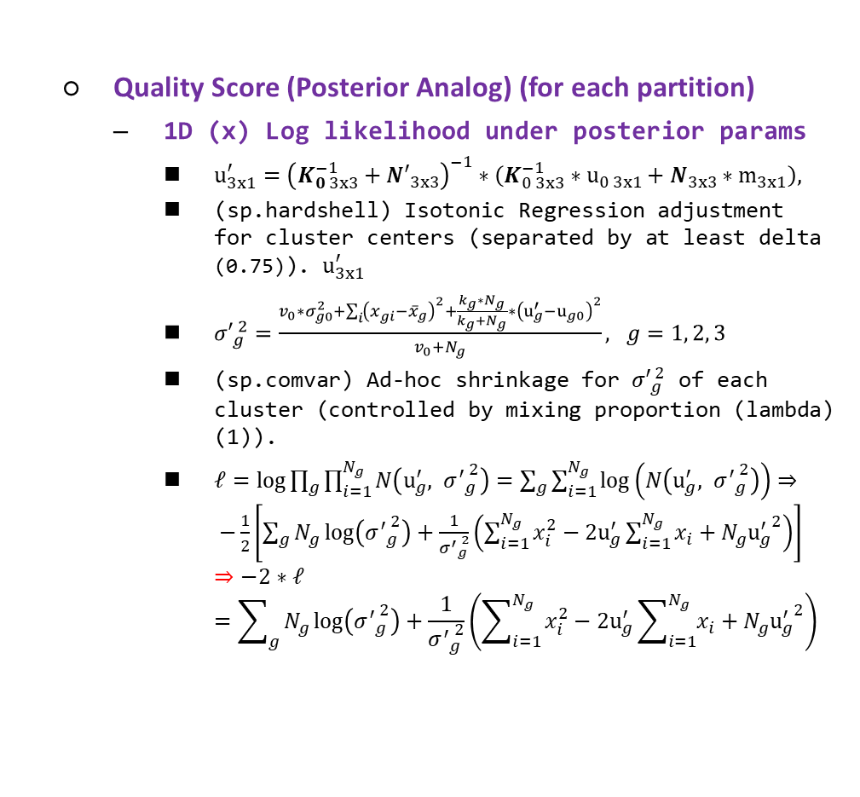
Genotyping Analysis Development and Distribution
Training samples (CEL)
Quality Score (Posterior Analog) (for each partition)
1D (x) Log likelihood under posterior params
$u_{3x1}^{′}={\left(K_{0 3x3}^{−1}+{N′}_{3x3}\right)}^{−1}∗\left(K_{0 3x3}^{−1}∗u_{0 3x1}+N_{3x3}∗m_{3x1}\right),$
(sp.hardshell) Isotonic Regression adjustment for cluster centers (separated by at least delta (0.75)). $u_{3x1}^{′}$
${σ′}_{g}^{ 2}=\frac{v_{0}∗σ_{g0}^{2}+\sum_{i}{{\left(x_{gi}{−\overline{x}}_{g}\right)}^{2}}+\frac{k_{g}∗N_{g}}{k_{g}+N_{g}}∗{\left(u_{g}^{′}−u_{g0}\right)}^{2}}{v_{0}+N_{g}}, g=1, 2, 3$
(sp.comvar) Ad-hoc shrinkage for ${σ′}_{g}^{ 2}$ of each cluster (controlled by mixing proportion (lambda) (1)).
$ℓ=log{\prod_{g}{\prod_{i=1}^{N_{g}}{N\left(u_{g}^{′}, {σ^{′}}_{g}^{ 2}\right)}}}=\sum_{g}{\sum_{i=1}^{N_{g}}{\log\left(N\left(u_{g}^{′}, {σ^{′}}_{g}^{ 2}\right)\right)}}⇒ −\frac{1}{2}\left[\sum_{g}{N_{g}\log\left({σ^{′}}_{g}^{ 2}\right)+\frac{1}{{σ^{′}}_{g}^{ 2}}\left(\sum_{i=1}^{N_{g}}{x_{i}^{2}}−2u_{g}^{′}\sum_{i=1}^{N_{g}}{x_{i}}+N_{g}{u_{g}^{′}}^{2}\right)}\right]$
$$⇒−2∗ℓ=\sum_{g}{N_{g}\log\left({σ^{′}}_{g}^{ 2}\right)+\frac{1}{{σ^{′}}_{g}^{ 2}}\left(\sum_{i=1}^{N_{g}}{x_{i}^{2}}−2u_{g}^{′}\sum_{i=1}^{N_{g}}{x_{i}}+N_{g}{u_{g}^{′}}^{2}\right)}$$
Data and Parameters Loader
Target Sketch Estimation
Quantile Normalization
Probe Sets Summarization
Alleles Summarization
Signal Space Transformation (MvA)
GMM Bayesian Update
Genotype Calls and Confidences

Slide 16
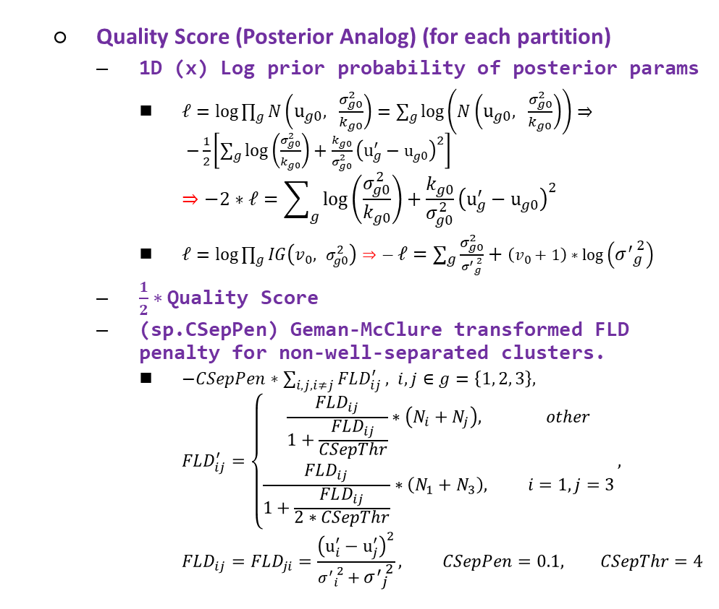
Genotyping Analysis Development and Distribution
Training samples (CEL)
Quality Score (Posterior Analog) (for each partition)
1D (x) Log prior probability of posterior params
$ℓ=log{\prod_{g}{N\left(u_{g0}, \frac{σ_{g0}^{2}}{k_{g0}}\right)}}=\sum_{g}{\log\left(N\left(u_{g0}, \frac{σ_{g0}^{2}}{k_{g0}}\right)\right)}⇒ −\frac{1}{2}\left[\sum_{g}{\log\left(\frac{σ_{g0}^{2}}{k_{g0}}\right)+\frac{k_{g0}}{σ_{g0}^{2}}}{\left(u_{g}^{′}−u_{g0}\right)}^{2}\right]$
$$⇒−2∗ℓ=\sum_{g}{\log\left(\frac{σ_{g0}^{2}}{k_{g0}}\right)+\frac{k_{g0}}{σ_{g0}^{2}}}{\left(u_{g}^{′}−u_{g0}\right)}^{2}$$
$ℓ=log{\prod_{g}{IG\left(v_{0}, σ_{g0}^{2}\right)}}⇒− ℓ=\sum_{g}{\frac{σ_{g0}^{2}}{{σ^{′}}_{g}^{ 2}}+\left(v_{0}+1\right)∗\log\left({σ^{′}}_{g}^{ 2}\right)}$
$\frac{1}{2}∗$ Quality Score
(sp.CSepPen) Geman-McClure transformed FLD penalty for non-well-separated clusters.
$−CSepPen∗\sum_{i,j, i≠j}{FLD_{ij}^{′}}, i, j∈g=\left\{1, 2, 3\right\},$
$$FLD_{ij}^{′}=\left\{\begin{aligned}\frac{FLD_{ij}}{1+\frac{FLD_{ij}}{CSepThr}}∗\left(N_{i}+N_{j}\right), other \\ \frac{FLD_{ij}}{1+\frac{FLD_{ij}}{2∗CSepThr}}∗\left(N_{1}+N_{3}\right), i=1, j=3\end{aligned}\right.,$$
$$FLD_{ij}=FLD_{ji}=\frac{{\left(u_{i}^{′}−u_{j}^{′}\right)}^{2}}{{σ^{′}}_{i}^{ 2}+{σ^{′}}_{j}^{ 2}}, CSepPen=0.1, CSepThr=4$$
Data and Parameters Loader
Target Sketch Estimation
Quantile Normalization
Probe Sets Summarization
Alleles Summarization
Signal Space Transformation (MvA)
GMM Bayesian Update
Genotype Calls and Confidences

Slide 17
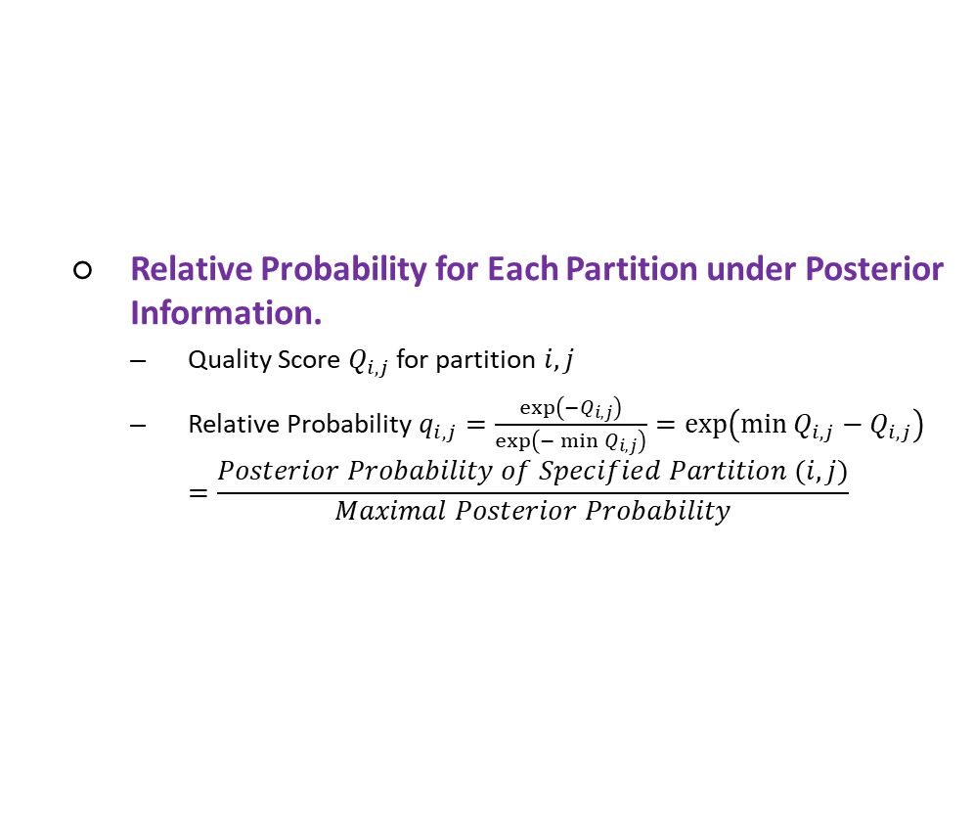
Genotyping Analysis Development and Distribution
Training samples (CEL)
Relative Probability for Each Partition under Posterior Information.
Quality Score $Q_{i, j}$ for partition $i, j$
Relative Probability $q_{i,j}=\frac{\exp\left(−Q_{i, j}\right)}{\exp\left(−\min{Q_{i,j}}\right)}=\exp\left(\min{Q_{i,j}}−Q_{i,j}\right)$
$$=\frac{Posterior Probability of Specified Partition (i,j)}{Maximal Posterior Probability}$$
Data and Parameters Loader
Target Sketch Estimation
Quantile Normalization
Probe Sets Summarization
Alleles Summarization
Signal Space Transformation (MvA)
GMM Bayesian Update
Genotype Calls and Confidences

Slide 18
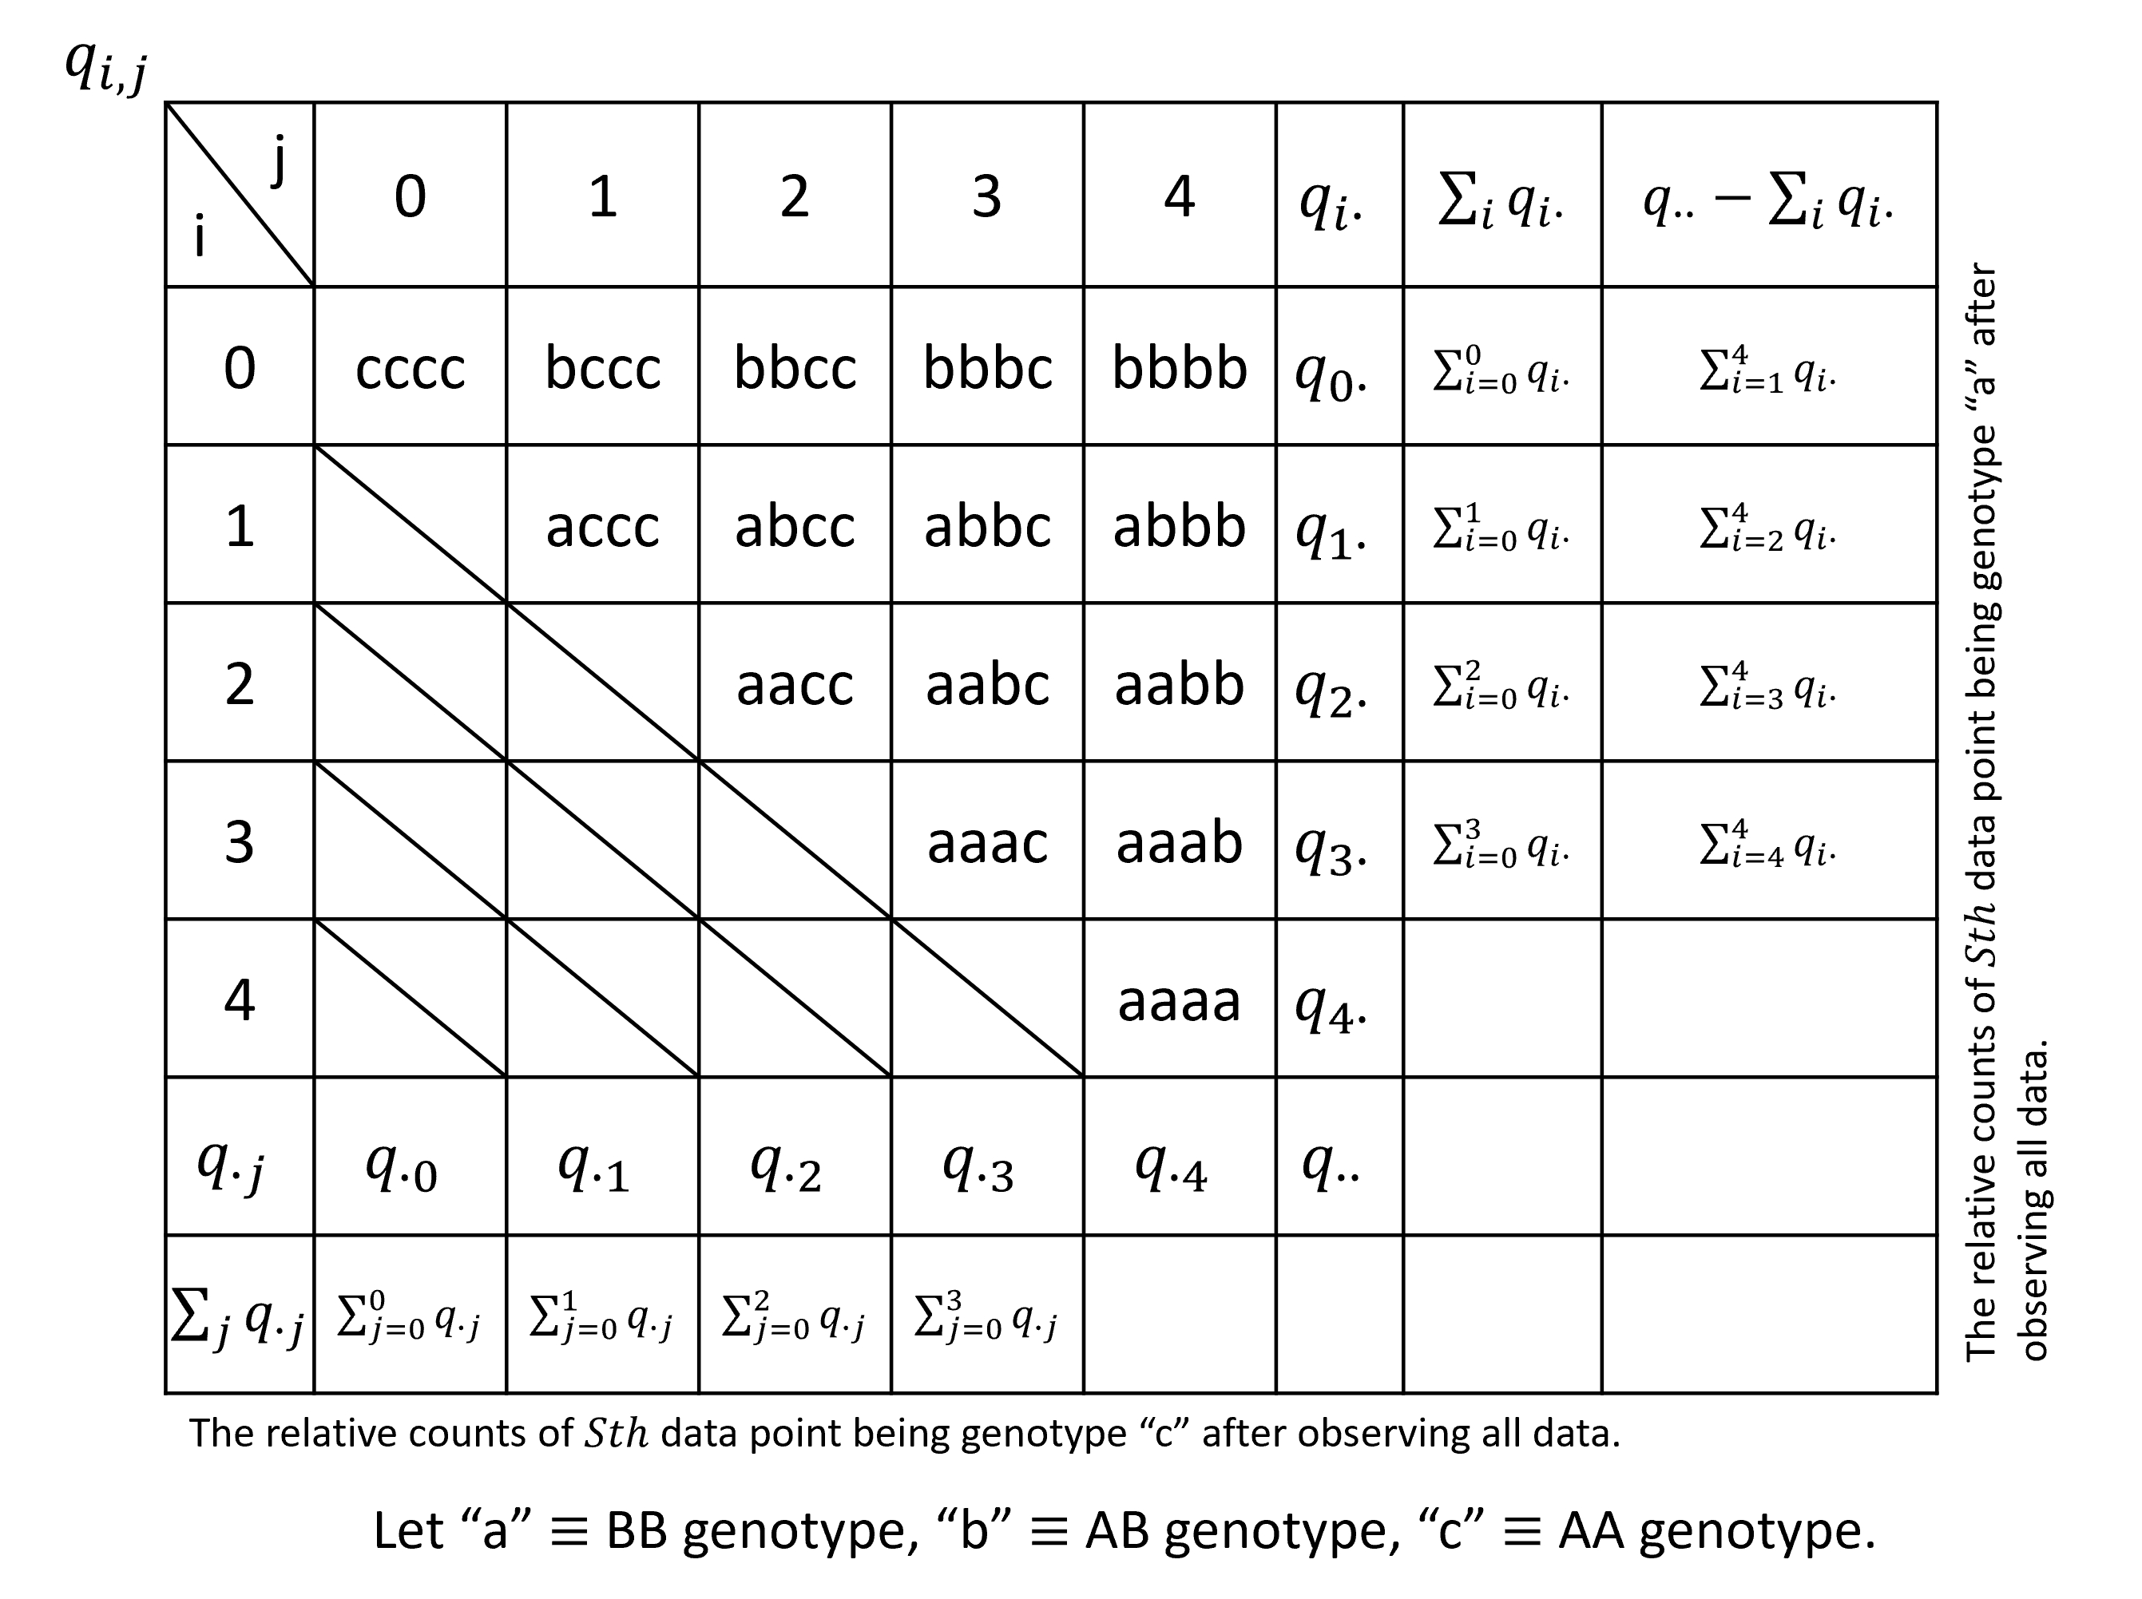
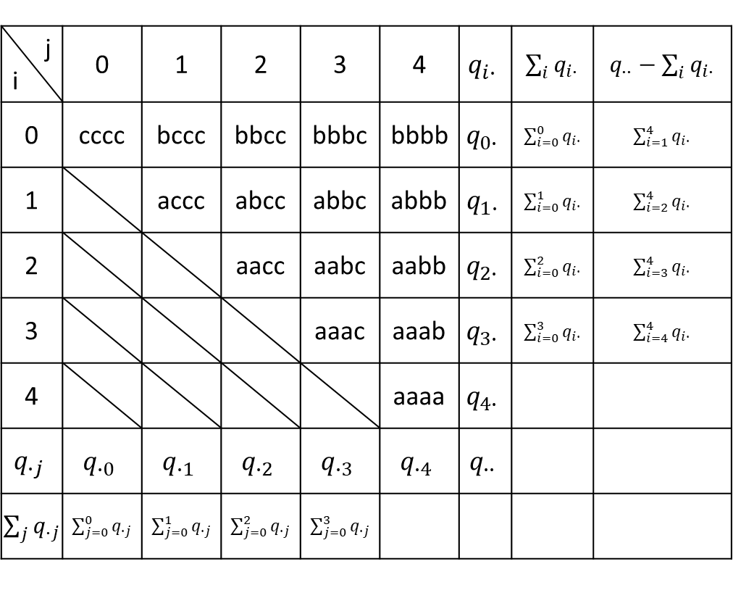
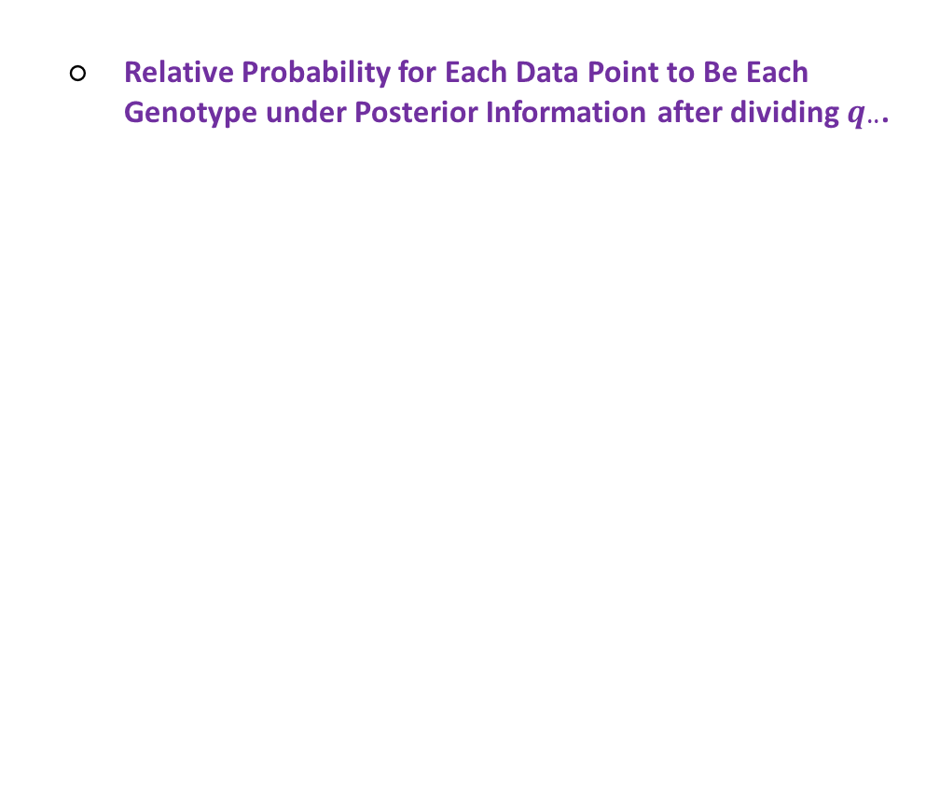
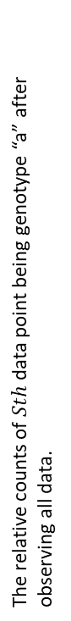
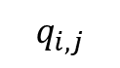
Genotyping Analysis Development and Distribution
Training samples (CEL)
Relative Probability for Each Data Point to Be Each Genotype under Posterior Information after dividing $q_{∙∙}$.
Data and Parameters Loader
Target Sketch Estimation
Quantile Normalization
Probe Sets Summarization
Alleles Summarization
Signal Space Transformation (MvA)
GMM Bayesian Update
Genotype Calls and Confidences
$$q_{i,j}$$
j i | 0 | 1 | 2 | 3 | 4 | $$q_{i∙}$$ | $\sum_{i}{q_{i∙}}$ | $q_{∙∙}−\sum_{i}{q_{i∙}}$
0 | cccc | bccc | bbcc | bbbc | bbbb | $$q_{0∙}$$ | $\sum_{i=0}^{0}{q_{i∙}}$ | $\sum_{i=1}^{4}{q_{i∙}}$
1 |  | accc | abcc | abbc | abbb | $$q_{1∙}$$ | $\sum_{i=0}^{1}{q_{i∙}}$ | $\sum_{i=2}^{4}{q_{i∙}}$
2 |  |  | aacc | aabc | aabb | $$q_{2∙}$$ | $\sum_{i=0}^{2}{q_{i∙}}$ | $\sum_{i=3}^{4}{q_{i∙}}$
3 |  |  |  | aaac | aaab | $$q_{3∙}$$ | $\sum_{i=0}^{3}{q_{i∙}}$ | $\sum_{i=4}^{4}{q_{i∙}}$
4 |  |  |  |  | aaaa | $$q_{4∙}$$
$$q_{∙j}$$ | $$q_{∙0}$$ | $$q_{∙1}$$ | $$q_{∙2}$$ | $$q_{∙3}$$ | $$q_{∙4}$$ | $$q_{∙∙}$$
$\sum_{j}{q_{∙j}}$ | $\sum_{j=0}^{0}{q_{∙j}}$ | $\sum_{j=0}^{1}{q_{∙j}}$ | $\sum_{j=0}^{2}{q_{∙j}}$ | $\sum_{j=0}^{3}{q_{∙j}}$
The relative counts of $Sth$ data point being genotype “a” after observing all data.
The relative counts of $Sth$ data point being genotype “c” after observing all data.
Let “a” $≡$ BB genotype, “b” $≡$ AB genotype, “c” $≡$ AA genotype.

Slide 19
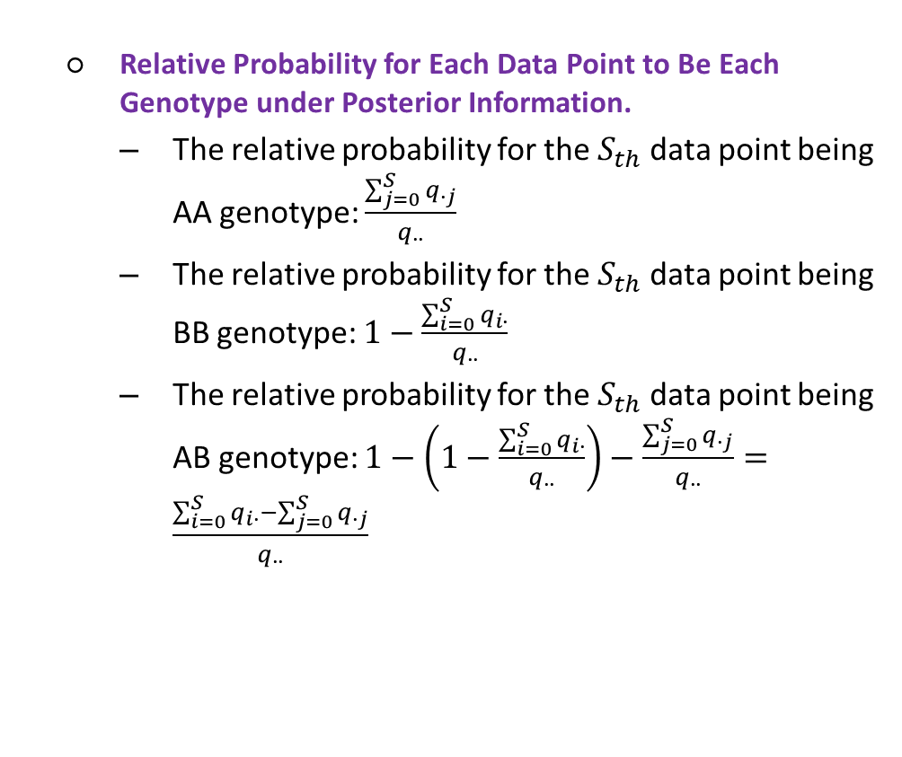
Genotyping Analysis Development and Distribution
Training samples (CEL)
Relative Probability for Each Data Point to Be Each Genotype under Posterior Information.
The relative probability for the $S_{th}$ data point being AA genotype: $\frac{\sum_{j=0}^{S}{q_{∙j}}}{q_{∙∙}}$
The relative probability for the $S_{th}$ data point being BB genotype: $1−\frac{\sum_{i=0}^{S}{q_{i∙}}}{q_{∙∙}}$
The relative probability for the $S_{th}$ data point being AB genotype: $1−\left(1−\frac{\sum_{i=0}^{S}{q_{i∙}}}{q_{∙∙}}\right)−\frac{\sum_{j=0}^{S}{q_{∙j}}}{q_{∙∙}}=\frac{\sum_{i=0}^{S}{q_{i∙}}−\sum_{j=0}^{S}{q_{∙j}}}{q_{∙∙}}$
Data and Parameters Loader
Target Sketch Estimation
Quantile Normalization
Probe Sets Summarization
Alleles Summarization
Signal Space Transformation (MvA)
GMM Bayesian Update
Genotype Calls and Confidences
$$q_{i,j}$$
j i | 0 | 1 | 2 | 3 | 4 | $$q_{i∙}$$ | $\sum_{i}{q_{i∙}}$ | $q_{∙∙}−\sum_{i}{q_{i∙}}$
0 | cccc | bccc | bbcc | bbbc | bbbb | $$q_{0∙}$$ | $\sum_{i=0}^{0}{q_{i∙}}$ | $\sum_{i=1}^{4}{q_{i∙}}$
1 |  | accc | abcc | abbc | abbb | $$q_{1∙}$$ | $\sum_{i=0}^{1}{q_{i∙}}$ | $\sum_{i=2}^{4}{q_{i∙}}$
2 |  |  | aacc | aabc | aabb | $$q_{2∙}$$ | $\sum_{i=0}^{2}{q_{i∙}}$ | $\sum_{i=3}^{4}{q_{i∙}}$
3 |  |  |  | aaac | aaab | $$q_{3∙}$$ | $\sum_{i=0}^{3}{q_{i∙}}$ | $\sum_{i=4}^{4}{q_{i∙}}$
4 |  |  |  |  | aaaa | $$q_{4∙}$$
$$q_{∙j}$$ | $$q_{∙0}$$ | $$q_{∙1}$$ | $$q_{∙2}$$ | $$q_{∙3}$$ | $$q_{∙4}$$ | $$q_{∙∙}$$
$\sum_{j}{q_{∙j}}$ | $\sum_{j=0}^{0}{q_{∙j}}$ | $\sum_{j=0}^{1}{q_{∙j}}$ | $\sum_{j=0}^{2}{q_{∙j}}$ | $\sum_{j=0}^{3}{q_{∙j}}$
The relative counts of $Sth$ data point being genotype “a” after observing all data.
The relative counts of $Sth$ data point being genotype “c” after observing all data.
Let “a” $≡$ BB genotype, “b” $≡$ AB genotype, “c” $≡$ AA genotype.

Slide 20
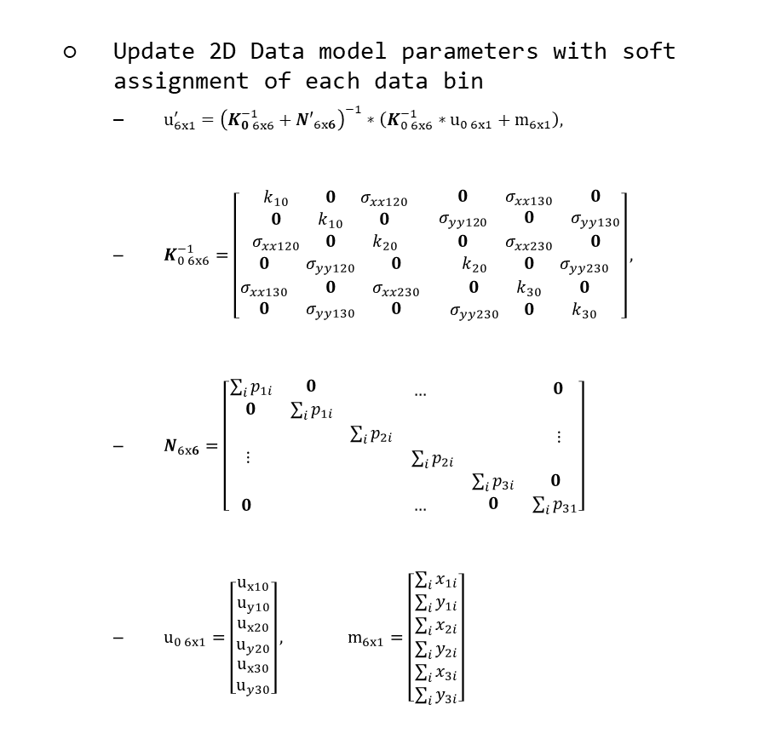
Genotyping Analysis Development and Distribution
Training samples (CEL)
Update 2D Data model parameters with soft assignment of each data bin
$u_{6x1}^{′}={\left(K_{0 6x6}^{−1}+{N′}_{6x6}\right)}^{−1}∗\left(K_{0 6x6}^{−1}∗u_{0 6x1}+m_{6x1}\right),$
$K_{0 6x6}^{−1}=\left[\begin{matrix}\begin{matrix}k_{10} & 0 & σ_{xx120} \\ 0 & k_{10} & 0 \\ σ_{xx120} & 0 & k_{20}\end{matrix} & \begin{matrix}0 & σ_{xx130} & 0 \\ σ_{yy120} & 0 & σ_{yy130} \\ 0 & σ_{xx230} & 0\end{matrix} \\ \begin{matrix}0 & σ_{yy120} & 0 \\ σ_{xx130} & 0 & σ_{xx230} \\ 0 & σ_{yy130} & 0\end{matrix} & \begin{matrix}k_{20} & 0 & σ_{yy230} \\ 0 & k_{30} & 0 \\ σ_{yy230} & 0 & k_{30}\end{matrix}\end{matrix}\right],$
$N_{6x6}=\left[\begin{matrix}\begin{matrix}\sum_{i}{p_{1i}} & 0 \\ 0 & \sum_{i}{p_{1i}}\end{matrix} & \begin{matrix} & … \\ & \end{matrix} & \begin{matrix} & 0 \\ & \end{matrix} \\ \begin{matrix} & \\ ⋮ & \end{matrix} & \begin{matrix}\sum_{i}{p_{2i}} & \\ & \sum_{i}{p_{2i}}\end{matrix} & \begin{matrix} & ⋮ \\ & \end{matrix} \\ \begin{matrix} & \\ 0 & \end{matrix} & \begin{matrix} & \\ & …\end{matrix} & \begin{matrix}\sum_{i}{p_{3i}} & 0 \\ 0 & \sum_{i}{p_{31}}\end{matrix}\end{matrix}\right]$
$u_{0 6x1}=\left[\begin{matrix}\begin{matrix}u_{x10} \\ u_{y10}\end{matrix} \\ \begin{matrix}u_{x20} \\ u_{y20}\end{matrix} \\ \begin{matrix}u_{x30} \\ u_{y30}\end{matrix}\end{matrix}\right], m_{6x1}=\left[\begin{matrix}\begin{matrix}\sum_{i}{x_{1i}} \\ \sum_{i}{y_{1i}}\end{matrix} \\ \begin{matrix}\sum_{i}{x_{2i}} \\ \sum_{i}{y_{2i}}\end{matrix} \\ \begin{matrix}\sum_{i}{x_{3i}} \\ \sum_{i}{y_{3i}}\end{matrix}\end{matrix}\right]$
Data and Parameters Loader
Target Sketch Estimation
Quantile Normalization
Probe Sets Summarization
Alleles Summarization
Signal Space Transformation (MvA)
GMM Bayesian Update
Genotype Calls and Confidences

Slide 21
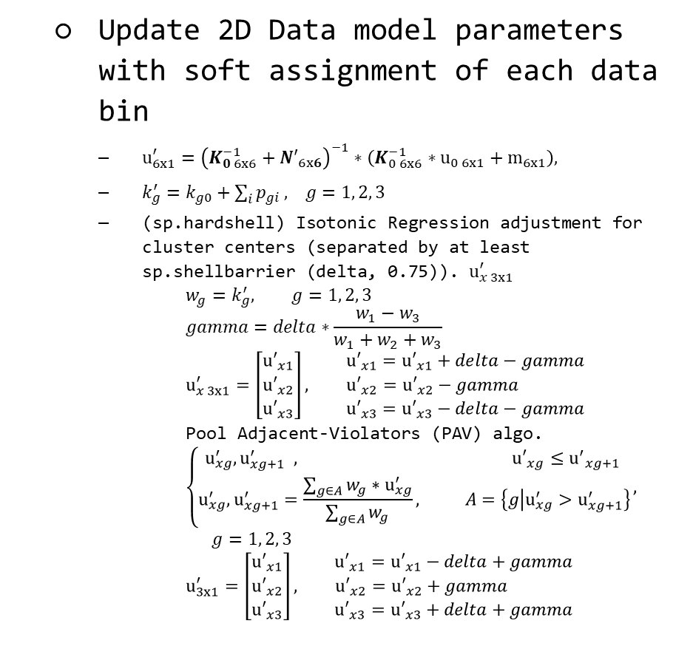
Genotyping Analysis Development and Distribution
Training samples (CEL)
Update 2D Data model parameters with soft assignment of each data bin
$u_{6x1}^{′}={\left(K_{0 6x6}^{−1}+{N′}_{6x6}\right)}^{−1}∗\left(K_{0 6x6}^{−1}∗u_{0 6x1}+m_{6x1}\right),$
$k_{g}^{′}=k_{g0}+\sum_{i}{p_{gi}}, g=1, 2, 3$
(sp.hardshell) Isotonic Regression adjustment for cluster centers (separated by at least sp.shellbarrier (delta, 0.75)). $u_{x 3x1}^{′}$
$$w_{g}=k_{g}^{′}, g=1, 2, 3$$
$$gamma=delta∗\frac{w_{1}−w_{3}}{w_{1}+w_{2}+w_{3}}$$
$$u_{x 3x1}^{′}=\left[\begin{matrix}{u′}_{x1} \\ {u′}_{x2} \\ {u′}_{x3}\end{matrix}\right], \begin{matrix}{u′}_{x1}={u′}_{x1}+delta−gamma \\ {u′}_{x2}={u′}_{x2}−gamma \\ {u′}_{x3}={u′}_{x3}−delta−gamma\end{matrix}$$
Pool Adjacent-Violators (PAV) algo.
$$\left\{\begin{aligned}u_{xg}^{′}, u_{xg+1}^{′} , {u′}_{xg}≤{u^{′}}_{xg+1} \\ u_{xg}^{′}, u_{xg+1}^{′}=\frac{\sum_{g∈A}{w_{g}}∗u_{xg}^{′}}{\sum_{g∈A}{w_{g}}}, A=\left\{g | u_{xg}^{′}>u_{xg+1}^{′}\right\}\end{aligned}\right.,$$
$$g=1, 2, 3$$
$$u_{3x1}^{′}=\left[\begin{matrix}{u′}_{x1} \\ {u′}_{x2} \\ {u′}_{x3}\end{matrix}\right], \begin{matrix}{u′}_{x1}={u′}_{x1}−delta+gamma \\ {u′}_{x2}={u′}_{x2}+gamma \\ {u′}_{x3}={u′}_{x3}+delta+gamma\end{matrix}$$
Data and Parameters Loader
Target Sketch Estimation
Quantile Normalization
Probe Sets Summarization
Alleles Summarization
Signal Space Transformation (MvA)
GMM Bayesian Update
Genotype Calls and Confidences

Slide 22
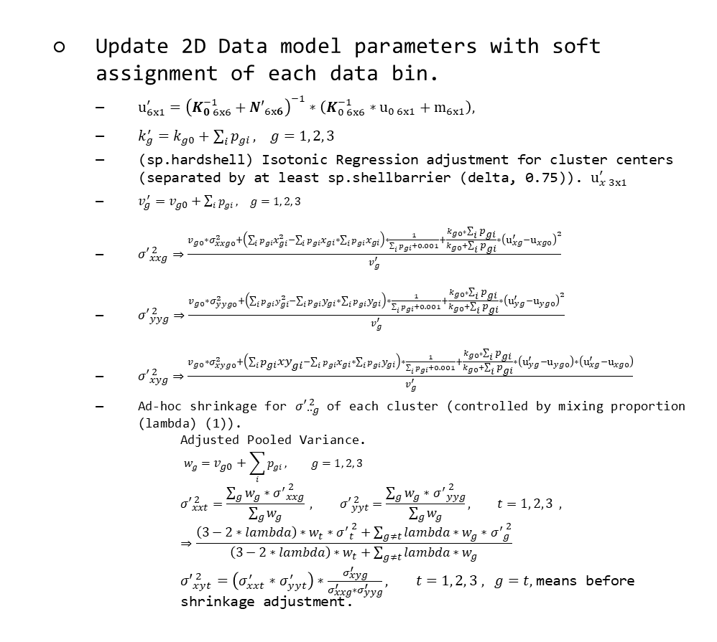
Genotyping Analysis Development and Distribution
Training samples (CEL)
Update 2D Data model parameters with soft assignment of each data bin.
$u_{6x1}^{′}={\left(K_{0 6x6}^{−1}+{N′}_{6x6}\right)}^{−1}∗\left(K_{0 6x6}^{−1}∗u_{0 6x1}+m_{6x1}\right),$
$k_{g}^{′}=k_{g0}+\sum_{i}{p_{gi}}, g=1, 2, 3$
(sp.hardshell) Isotonic Regression adjustment for cluster centers (separated by at least sp.shellbarrier (delta, 0.75)). $u_{x 3x1}^{′}$
$v_{g}^{′}=v_{g0}+\sum_{i}{p_{gi}}, g=1, 2, 3$
${σ′}_{xxg}^{ 2}⇒\frac{v_{g0}∗σ_{xxg0}^{2}+\left(\sum_{i}{{p_{gi}x}_{gi}^{2}}−\sum_{i}{p_{gi}x_{gi}}∗\sum_{i}{p_{gi}x_{gi}}\right)∗\frac{1}{\sum_{i}{p_{gi}}+0.001}+\frac{k_{g0}∗\sum_{i}{p_{gi}}}{k_{g0}+\sum_{i}{p_{gi}}}∗{\left(u_{xg}^{′}−u_{xg0}\right)}^{2}}{v_{g}^{′}}$
${σ′}_{yyg}^{ 2}⇒\frac{v_{g0}∗σ_{yyg0}^{2}+\left(\sum_{i}{{p_{gi}y}_{gi}^{2}}−\sum_{i}{p_{gi}y_{gi}}∗\sum_{i}{p_{gi}y_{gi}}\right)∗\frac{1}{\sum_{i}{p_{gi}}+0.001}+\frac{k_{g0}∗\sum_{i}{p_{gi}}}{k_{g0}+\sum_{i}{p_{gi}}}∗{\left(u_{yg}^{′}−u_{yg0}\right)}^{2}}{v_{g}^{′}}$
${σ′}_{xyg}^{ 2}⇒\frac{v_{g0}∗σ_{xyg0}^{2}+\left(\sum_{i}{p_{gi}xy_{gi}}−\sum_{i}{p_{gi}x_{gi}}∗\sum_{i}{p_{gi}y_{gi}}\right)∗\frac{1}{\sum_{i}{p_{gi}}+0.001}+\frac{k_{g0}∗\sum_{i}{p_{gi}}}{k_{g0}+\sum_{i}{p_{gi}}}∗\left(u_{yg}^{′}−u_{yg0}\right)∗\left(u_{xg}^{′}−u_{xg0}\right)}{v_{g}^{′}}$
Ad-hoc shrinkage for ${σ′}_{∙∙g}^{ 2}$ of each cluster (controlled by mixing proportion (lambda) (1)).
Adjusted Pooled Variance.
$$w_{g}=v_{g0}+\sum_{i}{p_{gi}}, g=1, 2, 3$$
$${σ′}_{xxt}^{ 2}=\frac{\sum_{g}{w_{g}∗{σ^{′}}_{xxg}^{ 2}}}{\sum_{g}{w_{g}}} , {σ′}_{yyt}^{ 2}=\frac{\sum_{g}{w_{g}∗{σ^{′}}_{yyg}^{ 2}}}{\sum_{g}{w_{g}}}, t=1, 2, 3 , ⇒\frac{\left(3−2∗lambda\right)∗w_{t}∗{σ^{′}}_{t}^{ 2}+\sum_{g≠t}{lambda∗w_{g}∗{σ^{′}}_{g}^{ 2}}}{\left(3−2∗lambda\right)∗w_{t}+\sum_{g≠t}{lambda∗w_{g}}}$$
${σ′}_{xyt}^{ 2}=\left(σ_{xxt}^{′}∗σ_{yyt}^{′}\right)∗\frac{σ_{xyg}^{′}}{σ_{xxg}^{′}∗σ_{yyg}^{′}}, t=1, 2, 3 , g=t,$means before shrinkage adjustment.
Data and Parameters Loader
Target Sketch Estimation
Quantile Normalization
Probe Sets Summarization
Alleles Summarization
Signal Space Transformation (MvA)
GMM Bayesian Update
Genotype Calls and Confidences

Slide 23
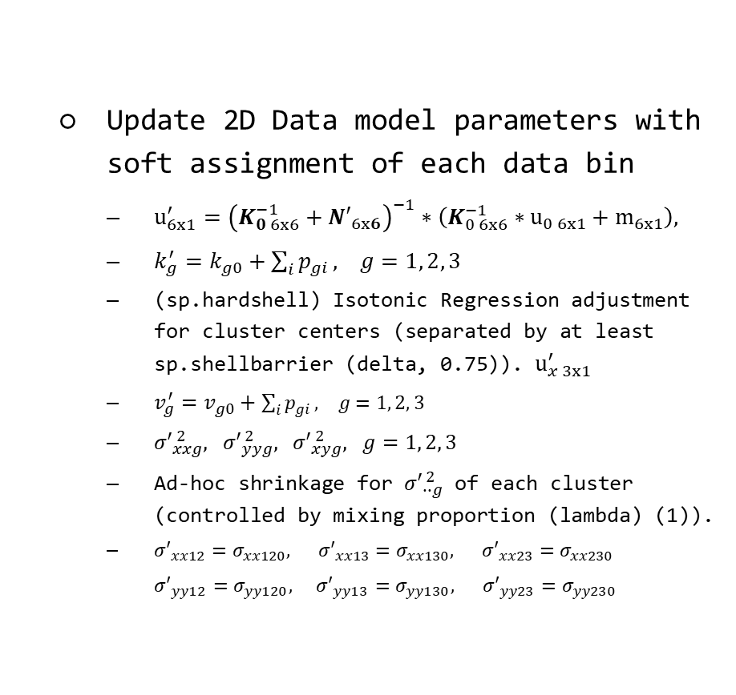
Genotyping Analysis Development and Distribution
Training samples (CEL)
Update 2D Data model parameters with soft assignment of each data bin
$u_{6x1}^{′}={\left(K_{0 6x6}^{−1}+{N′}_{6x6}\right)}^{−1}∗\left(K_{0 6x6}^{−1}∗u_{0 6x1}+m_{6x1}\right),$
$k_{g}^{′}=k_{g0}+\sum_{i}{p_{gi}}, g=1, 2, 3$
(sp.hardshell) Isotonic Regression adjustment for cluster centers (separated by at least sp.shellbarrier (delta, 0.75)). $u_{x 3x1}^{′}$
$v_{g}^{′}=v_{g0}+\sum_{i}{p_{gi}}, g=1, 2, 3$
${σ′}_{xxg}^{ 2}, {σ′}_{yyg}^{ 2}, {σ′}_{xyg}^{ 2}, g=1, 2, 3$
Ad-hoc shrinkage for ${σ′}_{∙∙g}^{ 2}$ of each cluster (controlled by mixing proportion (lambda) (1)).
${{σ′}_{xx12}=σ}_{xx120}, {{σ′}_{xx13}=σ}_{xx130}, {{σ′}_{xx23}=σ}_{xx230}$
${{σ′}_{yy12}=σ}_{yy120}, {{σ′}_{yy13}=σ}_{yy130}, {{σ′}_{yy23}=σ}_{yy230}$
Data and Parameters Loader
Target Sketch Estimation
Quantile Normalization
Probe Sets Summarization
Alleles Summarization
Signal Space Transformation (MvA)
GMM Bayesian Update
Genotype Calls and Confidences

Slide 24
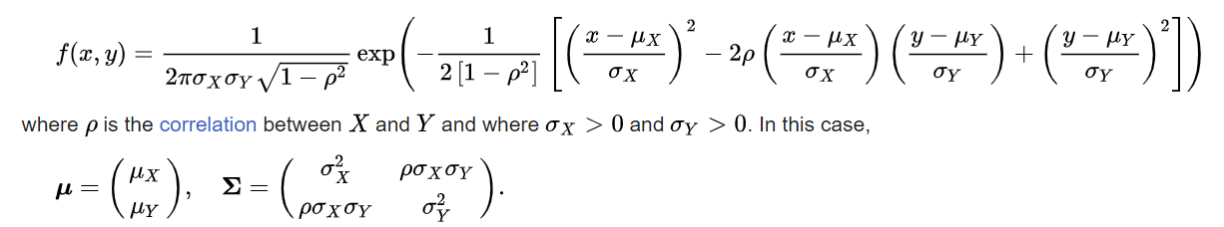
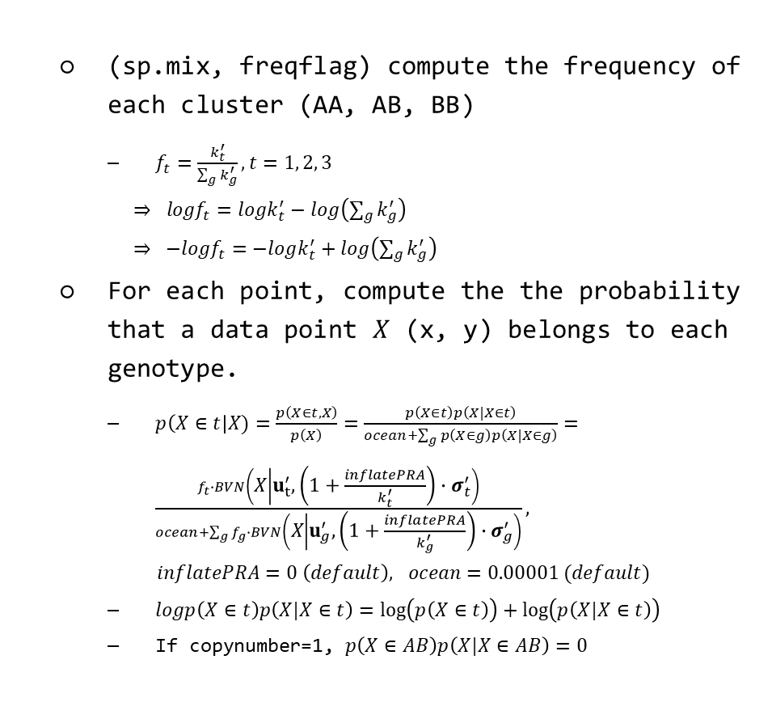
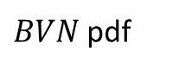
Genotyping Analysis Development and Distribution
(sp.mix, freqflag) compute the frequency of each cluster (AA, AB, BB)
$f_{t}=\frac{k_{t}^{′}}{\sum_{g}{k_{g}^{′}}}, t=1, 2, 3$
$⇒ logf_{t}=logk_{t}^{′}−log\left(\sum_{g}{k_{g}^{′}}\right)$
$⇒ −logf_{t}=−logk_{t}^{′}+log\left(\sum_{g}{k_{g}^{′}}\right)$
For each point, compute the the probability that a data point $X$ (x, y) belongs to each genotype.
$p\left(X∈t\right|X)=\frac{p\left(X∈t,X\right)}{p\left(X\right)}=\frac{p\left(X∈t\right)p\left(X|X∈t\right)}{ocean+\sum_{g}{p\left(X∈g\right)p\left(X|X∈g\right)}}=\frac{f_{t}∙BVN\left(X | u_{t}^{′}, \left(1+\frac{inflatePRA}{k_{t}^{′}}\right)∙σ_{t}^{′}\right)}{ocean+\sum_{g}{f_{g}∙BVN\left(X | u_{g}^{′},\left(1+\frac{inflatePRA}{k_{g}^{′}}\right)∙σ_{g}^{′}\right)}},$
$inflatePRA=0 \left(default\right), ocean=0.00001 (default)$
$logp\left(X∈t\right)p\left(X|X∈t\right)=\log\left(p\left(X∈t\right)\right)+\log\left(p\left(X|X∈t\right)\right)$
If copynumber=1, $p\left(X∈AB\right)p\left(X|X∈AB\right)=0$
Training samples (CEL)
Data and Parameters Loader
Target Sketch Estimation
Quantile Normalization
Probe Sets Summarization
Alleles Summarization
Signal Space Transformation (MvA)
GMM Bayesian Update
Genotype Calls and Confidences
$BVN$pdf

Slide 25
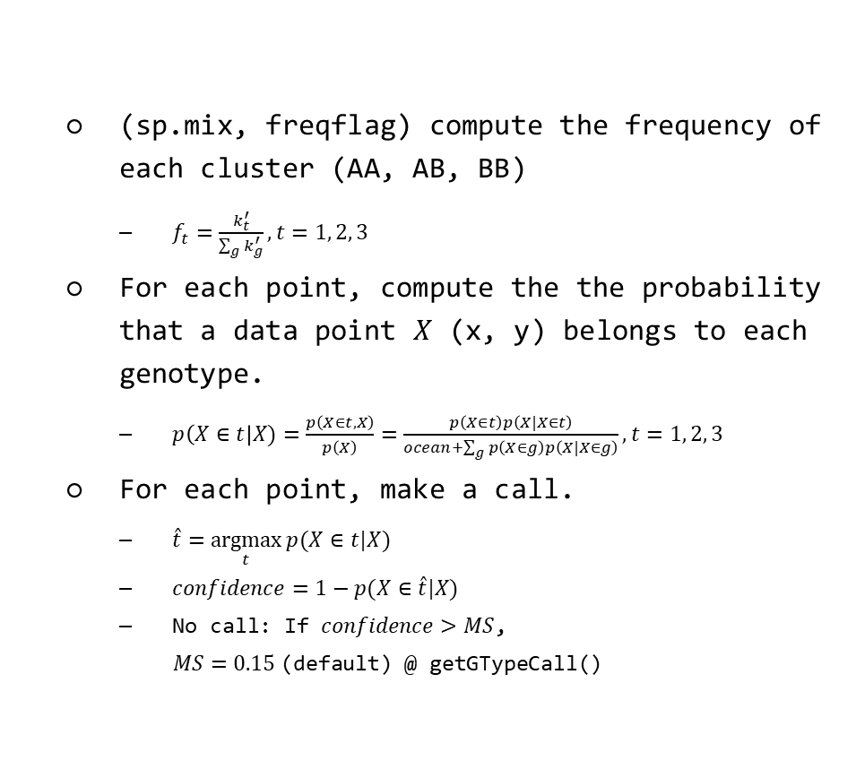
Genotyping Analysis Development and Distribution
Training samples (CEL)
(sp.mix, freqflag) compute the frequency of each cluster (AA, AB, BB)
$f_{t}=\frac{k_{t}^{′}}{\sum_{g}{k_{g}^{′}}}, t=1, 2, 3$
For each point, compute the the probability that a data point $X$ (x, y) belongs to each genotype.
$p\left(X∈t\right|X)=\frac{p\left(X∈t,X\right)}{p\left(X\right)}=\frac{p\left(X∈t\right)p\left(X|X∈t\right)}{ocean+\sum_{g}{p\left(X∈g\right)p\left(X|X∈g\right)}}, t=1, 2, 3$
For each point, make a call.
$\hat{t}=\underset{t}{argmax}{p(X∈t|X)}$
$confidence=1−p(X∈\hat{t}|X)$
No call: If $confidence>MS$,
$MS=0.15$(default) @ getGTypeCall()
Data and Parameters Loader
Target Sketch Estimation
Quantile Normalization
Probe Sets Summarization
Alleles Summarization
Signal Space Transformation (MvA)
GMM Bayesian Update
Genotype Calls and Confidences

Slide 26
Genotyping Analysis Development and Distribution
Evaluation Data: GSE78098
Platform: GPL21480 (Axiom_GW_Hu-CHB_SNP)
Focus on Chinese (Asian) people.
420 human samples
639653 Probe sets
Preprocessing and filter by DQC < 0.82
All 419 samples are picked.
Evaluation Data: Dog Banff
Platform: B1C (Banff)
187 dog samples
48283 Probe sets
Preprocessing for channel name, vcf allele definition, and change the coordinate system for the Y axis of the heatmap.
QC filter by NP probes performance (e.g. NP call rate, NP call slope).
155 dog samples are finally picked and used to build genotyping models.
Manual, Reports & Results: Project-CPT/CPT.wiki/AxiomGT.md at main · jeff665547/Project-CPT (github.com)
Notes:
Channel name caused by hdf5
VCF definition failure: correct => A: ref, B: alt
Image convert to heatmap: Y need to be inversed.

Slide 27
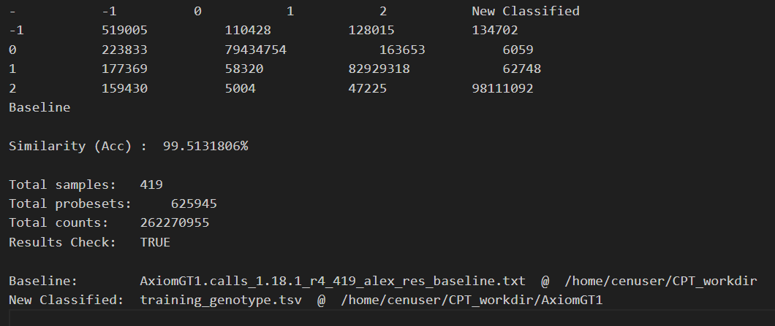
Genotyping Analysis Development and Distribution
Genotype Classification Results
 | -1 | 0 | 1 | 2
-1 | 519005 | 110428 | 128015 | 134702
0 | 223833 | 79434754 | 163653 | 6509
1 | 177369 | 58320 | 82929318 | 62748
2 | 159430 | 5004 | 47225 | 98111092
Similarity (Acc.): 99.5131806%
CPT
APT
Current progress
* Refine quantile normalization
* Model research and improvement
* Evaluation methods research and optimization
* Genotype labeling optimization

Slide 28
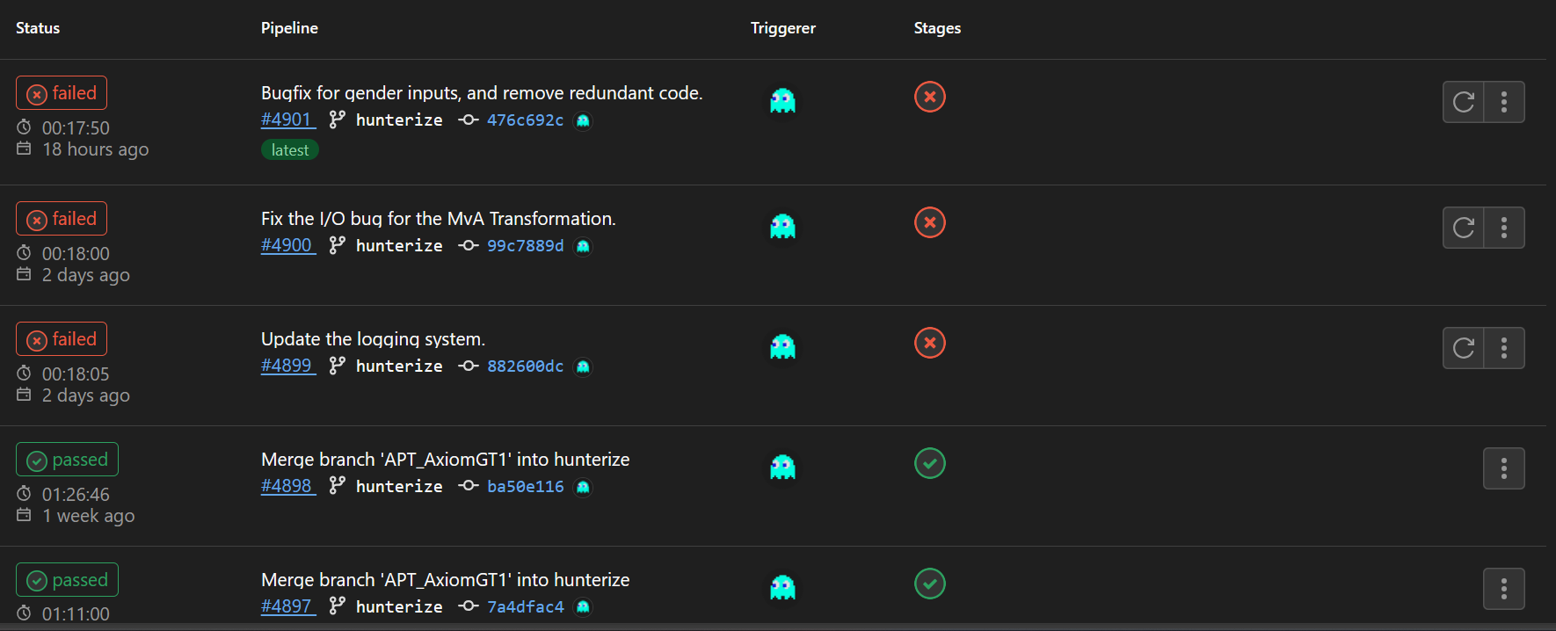
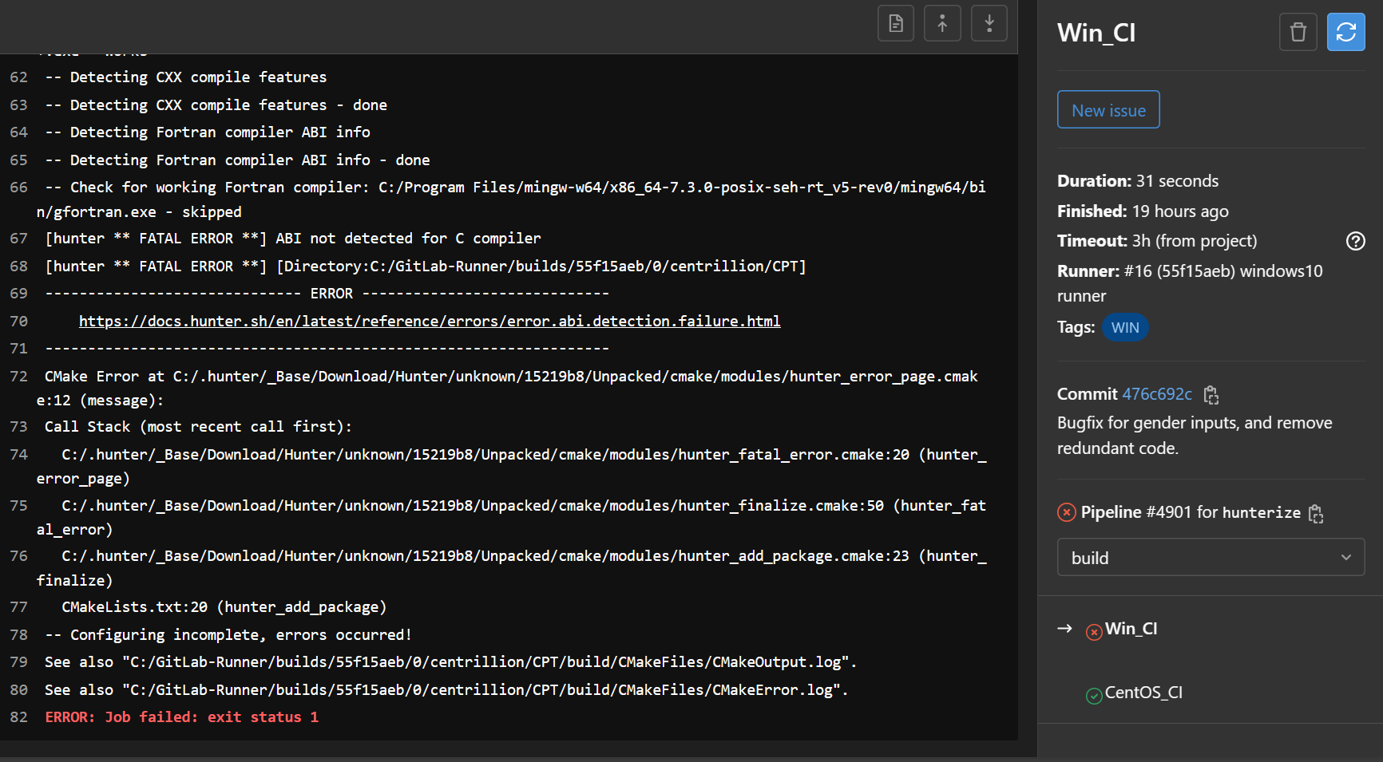
Genotyping Analysis Development and Distribution
Bugfix for the CI/CD error when deployment and distribution.
Notes:
Channel name caused by hdf5
VCF definition failure: correct => A: ref, B: alt
Image convert to heatmap: Y need to be inversed.

Slide 29
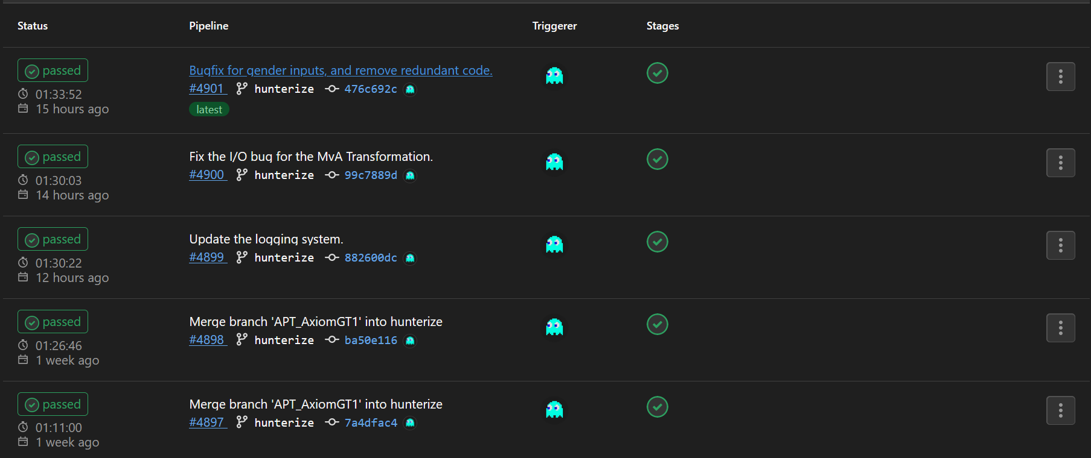
Genotyping Analysis Development and Distribution
Successful deployment and distribution.
Notes:
Channel name caused by hdf5
VCF definition failure: correct => A: ref, B: alt
Image convert to heatmap: Y need to be inversed.

Slide 30
Other Genotyping Models Research and Development
Jeff (CHI-HSUAN HO)

Slide 31
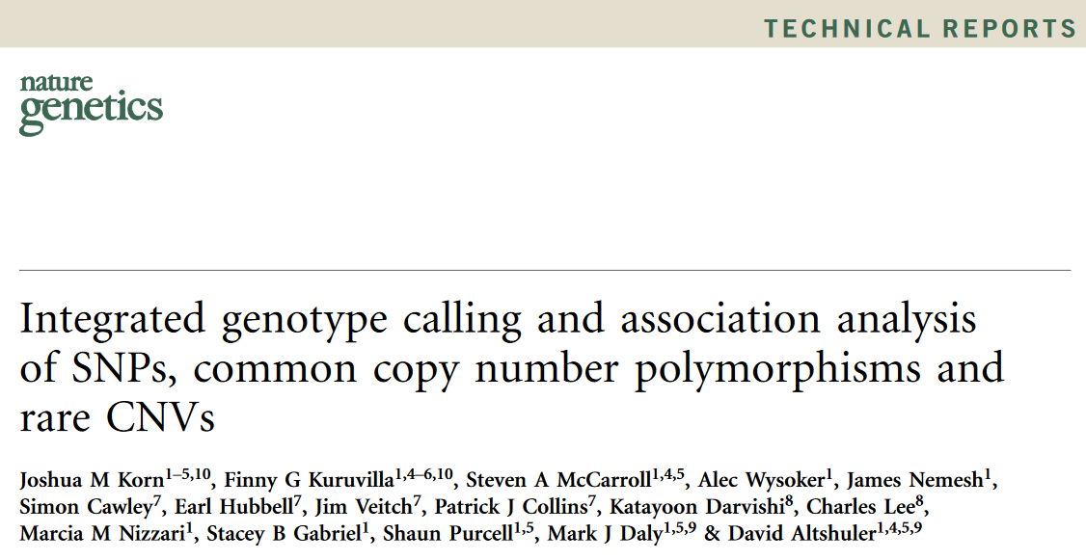
Progress Report and Future Work
Birdseed Framework
Training samples (CEL)
Data Loader
Target Sketch Estimation
Quantile Normalization
Allele Summarization
Signal Space Transformation
Birdseed/BRLMMp<Train>

Slide 32
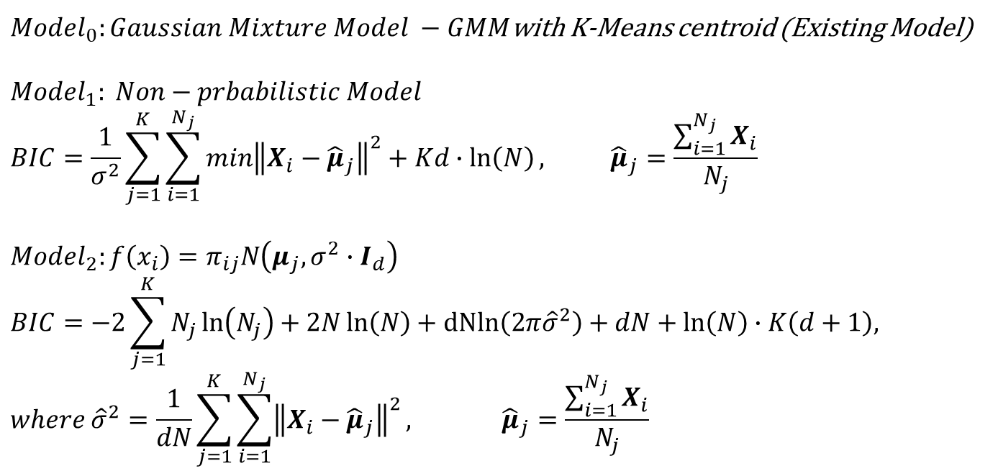
Genotyping Methods Evaluation and Simulation
Birdseed: K-means training model
$Model_{0}:Gaussian Mixture Model −GMM$with K-Means centroid (Existing Model)
$$Model_{1}: Non−prbabilistic Model$$
$$BIC=\frac{1}{σ^{2}}\sum_{j=1}^{K}{\sum_{i=1}^{N_{j}}{\min{{\left\|X_{i}−{\hat{μ}}_{j}\right\|}^{2}}}}+Kd∙\ln\left(N\right), {\hat{μ}}_{j}=\frac{\sum_{i=1}^{N_{j}}{X_{i}}}{N_{j}}$$
$$Model_{2}:f\left(x_{i}\right)=π_{ij}N\left(μ_{j},σ^{2}∙I_{d}\right)$$
$$BIC=−2\sum_{j=1}^{K}{N_{j}\ln\left(N_{j}\right)}+2N\ln\left(N\right)+dNln\left(2π{\hat{σ}}^{2}\right)+dN+\ln\left(N\right)∙K\left(d+1\right),$$
$$where {\hat{σ}}^{2}=\frac{1}{dN}\sum_{j=1}^{K}{\sum_{i=1}^{N_{j}}{{\left\|X_{i}−{\hat{μ}}_{j}\right\|}^{2}}}, {\hat{μ}}_{j}=\frac{\sum_{i=1}^{N_{j}}{X_{i}}}{N_{j}}$$

Slide 33
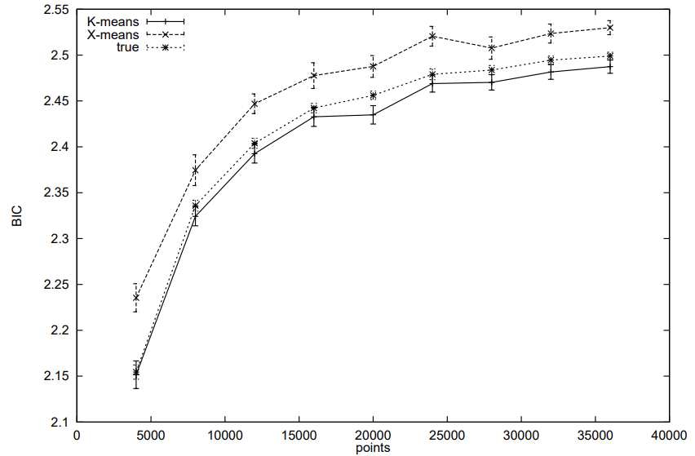

Genotyping Methods Evaluation and Simulation
-
$$Model_{2}$$

Slide 34

Genotyping Methods Evaluation and Simulation
Birdseed: K-means training model
$Model_{3}: ANOVA: X_{it}=μ_{it}+E_{it}, μ∈ℝ^{nxd}, E∈ℝ^{nxd}, E_{it} \sim iid N\left(0,σ^{2}\right), i=1, 2,…,N, t=1, 2, …, d$
$$BIC=Nd∙\ln\left(\sum_{j=1}^{K}{\sum_{i=1}^{N_{j}}{{\left\|X_{i}−{\hat{μ}}_{j}\right\|}^{2}}}\right)+Nd\left(1+\ln\left(\frac{2π}{Nd}\right)\right)$$
$+\ln\left(Nd\right)∙\left[Kd+\frac{1}{\tilde{σ}}\sum_{j=1}^{K^{′}}{\sum_{i=1}^{\tilde{N_{j}}}{\sum_{t=1}^{d}{\sum_{l≠c\left(i\right)}{φ\left(\frac{X_{i,t} + δ_{l}^{i,t} − {\tilde{μ}}_{i,t}}{\tilde{σ}}\right)}}}}∙\lim_{γ⇄δ_{l}^{i, t}}{ℳ{\left(X+γe_{i,t}\right)}_{i,t}}\right],$
$where {\tilde{σ}}^{2}=\frac{1}{dN}\sum_{j=1}^{K^{′}}{\sum_{i=1}^{\tilde{N_{j}}}{{\left\|X_{i}−{\tilde{μ}}_{i}\right\|}^{2}}}, \tilde{μ}=ℳ\left(X;K^{′}\right)$ for some $K^{′}>K,$
$φ\left(∙\right)$is the pdf of Normal (Gaussian) distribution,
$\lim_{γ⇄δ_{l}^{i, t}}{ℳ{\left(X+γe_{i,t}\right)}_{i,t}}={\left(−1\right)}^{I_{\left\{δ_{l}^{i, t}>0\right\}}}\left({\hat{μ}}_{c\left(i\right), t}−\frac{N_{l}}{N_{l}+1}{\hat{μ}}_{l, t}−\frac{X_{i,t}}{N_{l}+1}+δ_{l}^{i, t}\left(\frac{N_{l}+1−N_{c\left(i\right)}}{\left(N_{l}+1\right) ∙ N_{c\left(i\right)}}\right)\right)$,
$c\left(i\right)={argmin}_{lε\left\{1, 2, …, K\right\}}{\left\|X_{i}−{\hat{μ}}_{l}\right\|}^{2}$,
$\left(1−{\left(\frac{N_{c\left(i\right)}−1}{N_{c\left(i\right)}}\right)}^{2}\right){δ_{l}^{i, t}}^{2}+2∙\left(\left(X_{i,t}−{\hat{μ}}_{l, t}\right)−\left(X_{i,t}−{\hat{μ}}_{c\left(i\right), t}\right)∙\left(\frac{N_{c\left(i\right)}−1}{N_{c\left(i\right)}}\right)\right)δ_{l}^{i, t}+{\left(X_{i,t}−{\hat{μ}}_{l, t}\right)}^{2}−{\left(X_{i,t}−{\hat{μ}}_{c\left(i\right), t}\right)}^{2}=0$

Slide 35



Genotyping Methods Evaluation and Simulation
$$Model_{3}$$

Slide 36




Genotyping Methods Evaluation and Simulation
Birdseed: K-means training model
$Model_{0}:Equal weight Before scale: 94.1908\%$
$$Model_{0}:But differnet weight Before scale − Default \left(trim BIC, trim Fan\right):84.6841\% with very highly lose−classified rate.$$
$$Model_{0}:But differnet weight Before scale−no trim BIC:90.8778\%$$
$$Model_{0}:But differnet weight Before scale−no trim Fan:0\%$$
$$Model_{1}: Before scale − Default \left(trim BIC, trim Fan\right):98.3863\% with very highly lose−classified rate.$$
$$Model_{1}: Before scale −no trim BIC:98.6603\% →98.7585\% (BIC under all data)$$
$$Model_{1}: Before scale −no trim Fan:98.4763\%$$
$$Model_{1}: After scale:94.3179\%$$

Slide 37





Genotyping Methods Evaluation and Simulation
Simulation
sol$k: $Model_{3}$
sol$k_: $Model_{1}: Before scale$
Ans: $k=2$

Slide 38


Genotyping Methods Evaluation and Simulation
Simulation
sol$k: $Model_{3}$
sol$k_: $Model_{1}: Before scale$
$$\text{Ans}\text{: }k=3$$

Slide 39
Intensity Extraction and Data collecting Software – Summit Grid Review, Improve & Evaluate
Jeff (CHI-HSUAN HO)

Slide 40





Gridding Development
Summit.Grid
Chip Spec Parameters Setup

Slide 41
Gridding Development
Summit.Grid
Bugfix for wrong nms_count (WARNING for S1C)
Original
Noise influence (WARNING for Y2B)

Slide 42



Gridding Development
Summit.Grid
Rescue mechanism for gridding bad fov (for erosion).

Slide 43


Gridding Development
Summit.Grid
PGD Images Processing.

Slide 44


Gridding Development
Summit Grid checking support.
AM1E
AM3
Notes:
Channel name caused by hdf5
VCF definition failure: correct => A: ref, B: alt
Image convert to heatmap: Y need to be inversed.

Slide 45

Performance for New Gridding Software
Summit.Grid
Old statistical method

Slide 46


Performance for New Gridding Software
Summit.Grid
New statistical method

Slide 47

Performance for New Gridding Software
Summit.Grid
Old statistical method

Slide 48

Performance for New Gridding Software
Summit.Grid
New statistical method

Slide 49




Sampling Distribution for Different Chip Scan Mode
Quick scan mode experiments
Sample: 5 YZ01 chips (7x7 FOVs) x 10 runs => 2450 FOVs
Estimation: Var(X+Y)
Bias_H
Bias_V
N (-0.97, 3.45²)
N (-0.47, 7.73²)
SUMMIT Test 2
Bias_H
Bias_V
N (-0.34, 8.60²)
N (-1.31, 7.39²)
SUMMIT Test 3

Slide 50


Sampling Distribution for Different Chip Scan Mode
Quick scan mode experiments
Sample: 5 YZ01 chips (7x7 FOVs) x 10 runs => 2450 FOVs
Estimation: Var(X+Y)
SUMMIT with precise sliding
N (-0.86, 2.47²)
Bias_H
N (-1.43, 7.23²)
Bias_V

Slide 51




Sampling Distribution for Different Chip Scan Mode
Regular high precision mode experiments
Sample: 5 YZ01 chips (7x7 FOVs) x 1 runs => 245 FOVs
Estimation: Var(X)
N (-0.57, 1.01²)
Bias_H
N (-1.32, 0.45²)
Bias_V
SUMMIT Test 2
Bias_H
Bias_V
N (-0.20, 0.89²)
N (-1.77, 0.29²)
SUMMIT Test 3

Slide 52


Sampling Distribution for Different Chip Scan Mode
Regular high precision mode experiments
Sample: 5 YZ01 chips (7x7 FOVs) x 1 runs => 245 FOVs
Estimation: Var(X)
SUMMIT with Precise Sliding
Bias_H
Bias_V
N (-1.09, 0.84²)
N (-1.14, 0.39²)

Slide 53

Statistical Conclusion from Experiments Results
Gridding
SUMMIT Parameters Estimation
Let $X≡r.v.$ of the displacement from changing the filter (BF -> fluorescent).
Let $Y≡r.v.$ of the displacement from relocating the plate to the same position.
In the quick scan mode,
Estimate $Var\left(X+Y\right)=Var\left(X\right)+Var\left(Y\right)$
In the regular high precision mode,
Estimate $Var(X)$ Only

Slide 54

Statistical Conclusion from Experiments Results
Gridding
Chebyshev’s Inequality
$P\left(\left|Z−μ\right|≥k∙σ\right)≤\frac{1}{k^{2}}$
A. Quick scan for estimating $Var\left(X+Y\right)$
$k=14.3,$ $σ=7.74$, Cover radius: 110.7 (pixels)
99.5% $↑$ confidence.
2.3 x BF_mark_size, Lower bound: 110.7 (pixels)
B. Regular scan for estimating $Var\left(X\right)$
$k=7.2, σ=1.01$, Cover radius: 7.272 (pixels)
98.06% $↑$ confidence.
0.15 x BF_mark_size
Normal Distribution
$P\left(\left|T−μ\right|<Z_{0.0025}∙σ\right)=\text{99.5\%}, Z_{0.0025}=2.807$, 99.5% confidence.
A. Quick scan for estimating $Var\left(X+Y\right)$
$σ=7.74$, Cover radius: 21.7 (pixels)
B. Regular scan for estimating $Var\left(X\right)$
$σ=1.01$, Cover radius: 2.8 (pixels)
Overall Performance - successfully recognized rate: nearly 100%.

Slide 55


Signal Intensity Extraction Techniques Comparison
Raw Data (NPcall Analyzer)

Slide 56
Signal Intensity Extraction Techniques Comparison
Raw Data (GT Caller)
No. | Data | Grid1 | Grid2_subpix | Grid2_subpix_cvfix | Ranking
1 | 85_46_20210324123447 | 92.225% | 93.225% | 93.358% | 3 | 2 | 1
2 | 85_68_20210303140400 | 93.333% | 92.650% | 92.450% | 1 | 2 | 3
3 | 85_69_20210303142117 | 93.325% | 92.991% | 92.958% | 1 | 2 | 3
4 | 85_76_20210303143808 | 92.492% | 93.266% | 93.050% | 3 | 1 | 2
5 | 85_77_20210303145506 | 93.058% | 94.208% | 94.192% | 3 | 1 | 2
6 | 90_21_20210325132601 | 98.667% | 99.600% | 98.825% | 3 | 1 | 2
7 | 90_54_20210324125308 | 98.175% | 98.369% | 98.183% | 3 | 1 | 2
8 | 90_62_20210324131130 | 98.500% | 98.392% | 98.458% | 1 | 3 | 2
9 | 90_70_20210324132953 | 98.108% | 97.942% | 97.950% | 1 | 3 | 2
10 | 90_77_20210325142116 | 97.950% | 98.158% | 98.158% | 3 | 1 | 1
11 | 95_38_20210324121430 | 99.092% | 99.008% | 99.025% | 1 | 3 | 2
12 | 95_76_20210324164230 | 99.666% | 99.666% | 99.683% | 2 | 2 | 1
13 | 95_77_20210221134715_94_8 | 99.392% | 99.416% | 99.408% | 3 | 1 | 2
14 | 95_77_20210324165927 | 99.583% | 99.608% | 99.608% | 3 | 1 | 1
15 | 95_78_20210221140401 | 99.367% | 99.316% | 99.333% | 1 | 3 | 2

Slide 57



Signal Intensity Extraction Techniques Comparison
Multiple data NP call results comparison (from finally 38 results)
$H_{0}:$ Grid1 intensity $≥$ Intensity extracted from new developed process (Grid2)
$H_{1}:$Grid1 intensity < Intensity extracted from new developed process (Grid2)

Slide 58
Normal Gamma Background Correction & Data Preprocess
Jeff (CHI-HSUAN HO)

Slide 59


Model Background and Introduction
Model Assumption
For each single array:
$$X_{j} = S_{j} + B_{j}$$
$BgC$: $X_{j}⇒S_{j}$ Enhance the biological validity of the results.

Slide 60

Methods and Materials
Models and Notations
For each single array $j$:
$$X_{j} = S_{j} + B_{j}$$
$X_{j}=\left\{\begin{aligned}S_{j}+B_{j}, j∈J⇒regular probes set \\ 0+B_{j}=B_{j}, j∈J_{0}⇒negative control probes set\end{aligned}\right.$
$X_{j}\sim f_{x}\left(x\right), S_{j}\sim f_{s}\left(s\right), B_{j}\sim f_{B}\left(b\right), S_{j} and B_{j} are independent.$
$N\left(μ, σ^{2}\right)⇒f_{μ, σ}^{norm}\left(x\right)=\frac{1}{\sqrt{2π}σ}\exp\left\{−\frac{{\left(x−μ\right)}^{2}}{2σ^{2}}\right\}$
$φ\left(x\right)⇒N\left(0, 1\right), Φ\left(t\right)=\int_{−∞}^{t}{φ\left(x\right)dx}$
$Gamma\left(k, θ\right)⇒f_{k, θ}^{gam}\left(x\right)=\frac{{\left(\frac{1}{θ}\right)}^{k}}{Γ\left(k\right)}x^{k−1}\exp\left\{−\frac{x}{θ}\right\}, k:shape parameter, θ:scale parameter$
$\overset{⇒}{k=1, θ=α}Exp\left(α\right)⇒f_{α}^{exp}\left(x\right)=\frac{1}{α}\exp\left\{\frac{x}{α}\right\}$

Slide 61

Methods and Materials
Models and Notations
$X_{j} = S_{j} + B_{j}$, ${ X}_{j}\sim f_{x}\left(x\right), S_{j}\sim f_{s}\left(s\right), B_{j}\sim f_{B}\left(b\right)$
By the convolution formula, $x_{j}=s_{j}+b_{j}⇒b_{j}=x_{j}−s_{j}⇒\left|J\right|=\left|\frac{db_{j}}{dx_{j}}\right|=1$
$⇒X_{j}\sim f_{x}\left(x\right)=\int_{−∞}^{∞}{f_{X,S}\left(x, s\right)ds}=\int_{−∞}^{∞}{f_{S, B}\left(s, x−s\right)\left|J\right|ds}=\int_{−∞}^{∞}{f_{S,B}\left(s, x−s\right)ds}= =\int_{−∞}^{∞}{f_{S}\left(s\right)f_{B}\left(x−s\right)ds}$
$⇒$ Estimated Signal: $\hat{S}\left(x\right)=E\left[S | X=x\right]=\int_{−∞}^{∞}{Sf_{S|X=x}\left(s\right)ds}=\int_{−∞}^{∞}{S\frac{f_{S,X}\left(s, x\right)}{f_{x}\left(x\right)}ds}$
$=\frac{\int_{−∞}^{∞}{Sf_{S,X}\left(s, x\right)ds}}{\int_{−∞}^{∞}{f_{S,X}\left(s, x\right)ds}}=\frac{\int_{−∞}^{∞}{Sf_{S}\left(s\right)f_{B}\left(x−s\right)ds}}{\int_{−∞}^{∞}{f_{S}\left(s\right)f_{B}\left(x−s\right)ds}}$
Thus, if $f_{x}\left(x\right)$is known $⇒$ $\hat{S}\left(x\right)$ is known.
No analytic expression $⇒$ Fast Fourier Transformation-based (fft) approximation.

Slide 62

Methods and Materials
The normexp Model
$S_{j}\sim f_{s}\left(s\right)=\left\{\begin{aligned}Exp\left(α\right), j∈J \\ 0, j∈J_{0}\end{aligned}\right., B_{j}\sim f_{B}\left(b\right)⇒N\left(μ, σ^{2}\right)$
$⇒X_{j}\sim f_{X}\left(x\right)≡f_{μ, σ, α}^{nexp}\left(x\right)=\frac{1}{α}\exp\left\{\frac{σ^{2}}{2α^{2}}−\frac{x−μ}{α}\right\}Φ\left(\overline{x}\right), where \overline{x}=\frac{\left(x−μ−\frac{σ^{2}}{α}\right)}{σ}$
$⇒{\hat{S}}^{nexp}\left(x | Θ\right)=σ\left(\overline{x}+\frac{φ\left(\overline{x}\right)}{Φ\left(\overline{x}\right)}\right), Θ=(μ, σ, α)$
If we know $\left(\hat{μ}, \hat{σ},\hat{α}\right) ⇒$ we know ${\hat{S}}^{nexp}\left(x\right)$
MLE
Adapted RMA
Non-parametric estimation (NP)
Bayesian estimation
The Parameter Estimation of normexp Model

Slide 63

Methods and Materials
The normal-gamma Model
$S_{j}\sim f_{s}\left(s\right)=\left\{\begin{aligned}Gamma\left(k, θ\right), j∈J \\ 0, j∈J_{0}\end{aligned}\right., B_{j}\sim f_{B}\left(b\right)⇒N\left(μ, σ^{2}\right)$
$⇒X_{j}\sim f_{X}\left(x\right)≡f_{μ, σ, k, θ}^{ng}\left(x\right)=∫f_{k, θ}^{gam}\left(t\right)f_{μ, σ}^{norm}\left(x−t\right)dt⇒fft−based approximation$
$⇒{\hat{S}}^{ng}\left(x | Θ\right)=\frac{∫sf_{k, θ}^{gam}\left(s\right)f_{μ, σ}^{norm}\left(x−s\right)ds}{f_{μ, σ, k, θ}^{ng}\left(x\right)}=\frac{kθ\left(∫f_{k+1, θ}^{gam}\left(s\right)f_{μ, σ}^{norm}\left(x−s\right)ds\right)}{f_{μ, σ, k, θ}^{ng}\left(x\right)}$
$=\frac{kθf_{μ, σ, k+1, θ}^{ng}\left(x\right)}{f_{μ, σ, k, θ}^{ng}\left(x\right)}$ $⇒fft−based approximation$
If we know $\left(\hat{μ}, \hat{σ}, \hat{k},\hat{θ}\right) ⇒$ we know ${\hat{S}}^{ng}\left(x\right)⇒{{\hat{S}}_{j}=\hat{S}}^{ng}\left(x_{j}\right)$
MLE with classical minimization algorithms (L-BFGS-B)
The Parameter Estimation of normal-gamma Model

Slide 64




Performance on the Real Data
Normal-gamma BgC.
For each single probe in each cluster (channel):
$$X_{j} = S_{j} + N_{j}$$
$Normal−gamma$Correction: $X_{j}⇒S_{j}$. Enhance the biological validity of the results.
$N_{j}$ repre sents the noise. $⇒$ Assumption: Normal distribution.
Remove $N_{j}$ and u se Gamma distribution to estimate $S_{j}$.
$X_{j}⇒$ Normal-gamma distribution.
$$Normal−$$
$$gamma$$
e.g. log(log(Chip 121))

Slide 65
Performance on the Real Data
GMM-EM + Normal-gamma BgC.
Set the related environment in R. (Data Preprocess, NP Probes, QN & log, QDA)
Set the corresponding evaluation tools in R. (NP call rate, No call rate)
Run the GMM-EM in R. (10 times => max NP call.)
Run the normal-gamma correction (all together) before running QDA.
Debug for the no call rate in the NP call analyzer.
An example: NP call Analyzer: NP call: 94.4%, call: 66.9%
NP call (log(log(·)))
GMM + EM | 94.2308%
QDA | 94.5863%
ALL_NG + QDA | 94.2774%
Call rate (log(log(·)))
GMM + EM | 66.8298%
QDA | 67.8205%
ALL_NG + QDA | 67.7681%

Slide 66




Data Preprocess
Data Example
94.4
90.0
Wafer | Chips | Np call rate (%) (NP call Analyzer)
198-04 | 121 | 94.4
197-02 | 230 | 90.0
198-15 | 277 | 85.1
197-02 | 233 | 78.7
85.1
78.7

Slide 67


Data Preprocess
Logarithm Effect

Slide 68


Data Preprocess
Logarithm Effect

Slide 69
Chip QC and NPcall Analyzer
Jeff (CHI-HSUAN HO)

Slide 70


Summit.NPCallAnalyzer
Chip No.54 Quality Control Chip NO.62 Quality Control

Slide 71


Summit.NPCallAnalyzer
A
B
C
Snowy rate $=\frac{x in B}{all points in A+B+C}$

Slide 72




Summit.NPCallAnalyzer
GMM-EM Results (log(log))
Misclassified data
NP call: 94.2308%
No Call Rate: 66.8298%

Slide 73

Banff chip QC – Violin Plot

Slide 74

Banff chip QC – Heatmap

Slide 75

Banff chip QC – Marker Raw Data

Slide 76


Correlation and Regression analysis (MCE vs. NP call)
Training data: 80% data
Model: $NPcall=−0.005+1.005∙(1−MCE)$
$R^{2}$: 99.96%
Testing data: 20% data
MSE: 5.999574703240224e-06
It still need NP data to calculate the MCE.

